Slide 1
UNITED COLLECTIONS
Open Resources for Teaching Special and Museum Collections

Slide 2
ACCESSING COLLECTIONS
Who are Collections For?

Slide 3
Group Brainstorm
Who are collections for? Why would people want to access them?

Slide 4
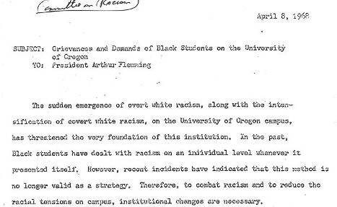
Black Student Union memo: Grievances and Demands of Black Students on the University of Oregon, 1968
Black Student Union memo: Grievances and Demands of Black Students on the University of Oregon, 1968-04-08,
UO Office of the President, Box 2, Special Collections & University Archives, University of Oregon Libraries, Eugene, Oregon

Slide 5
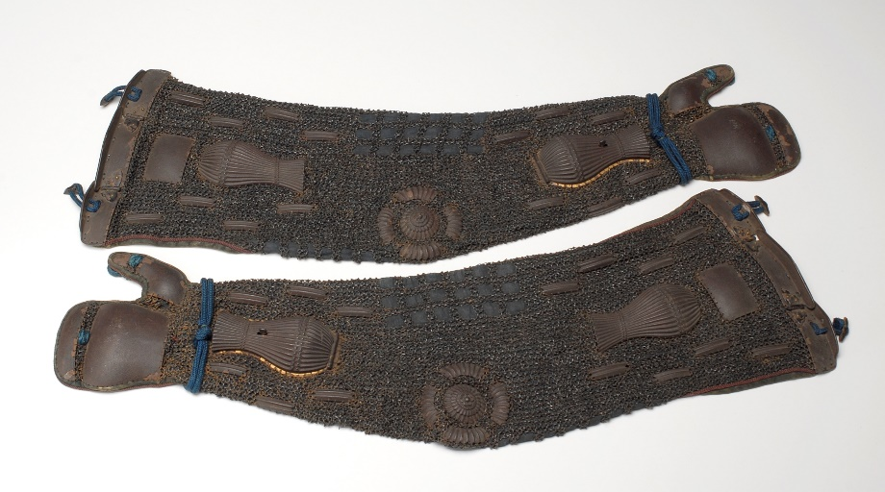
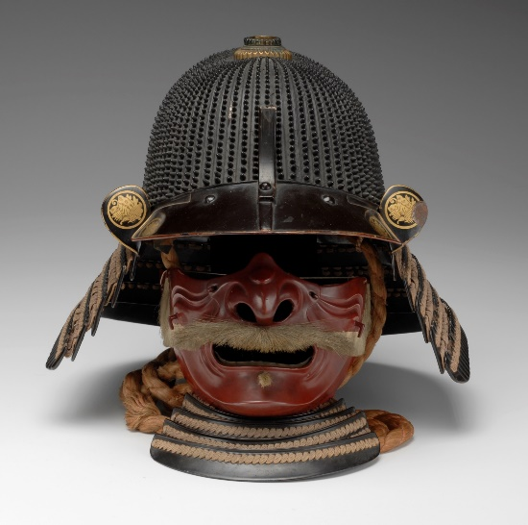
Suit of Armor
Japanese; Edo period,
Lacquer, metal, fabric
Jordan Schnitzer Museum of Art, University of Oregon; Murray Warner Collection of Oriental Art, MWJ64:2a-

Slide 6
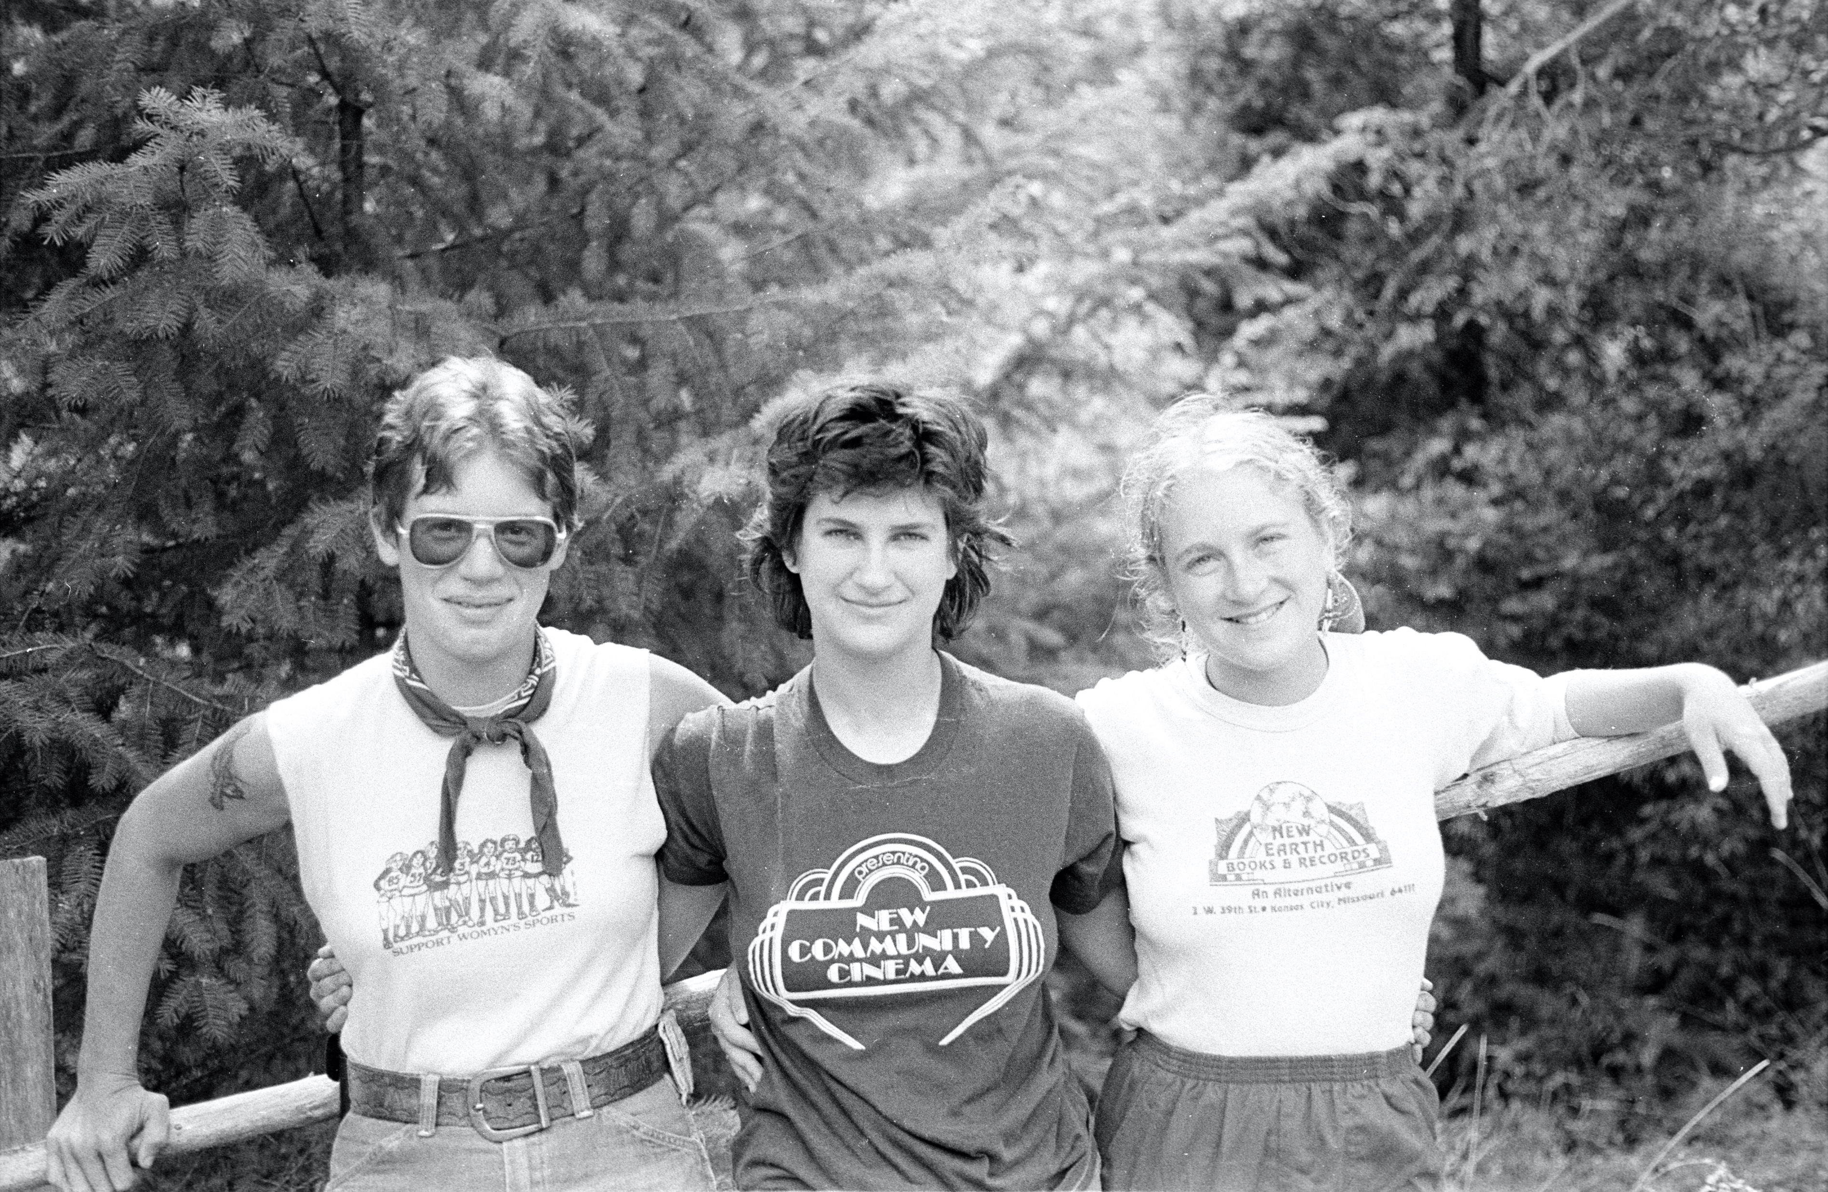
Photograph by Ruth Mountaingrove
[Untitled, Call309_A22_P3_0009], 1950/1999, Lesbian Intentional Community: Ruth Mountaingrove (b. 1923) photographs, Coll309, binder 22 contact sheet 3, Special Collections & University Archives, University of Oregon Libraries, Eugene, Oregon

Slide 7
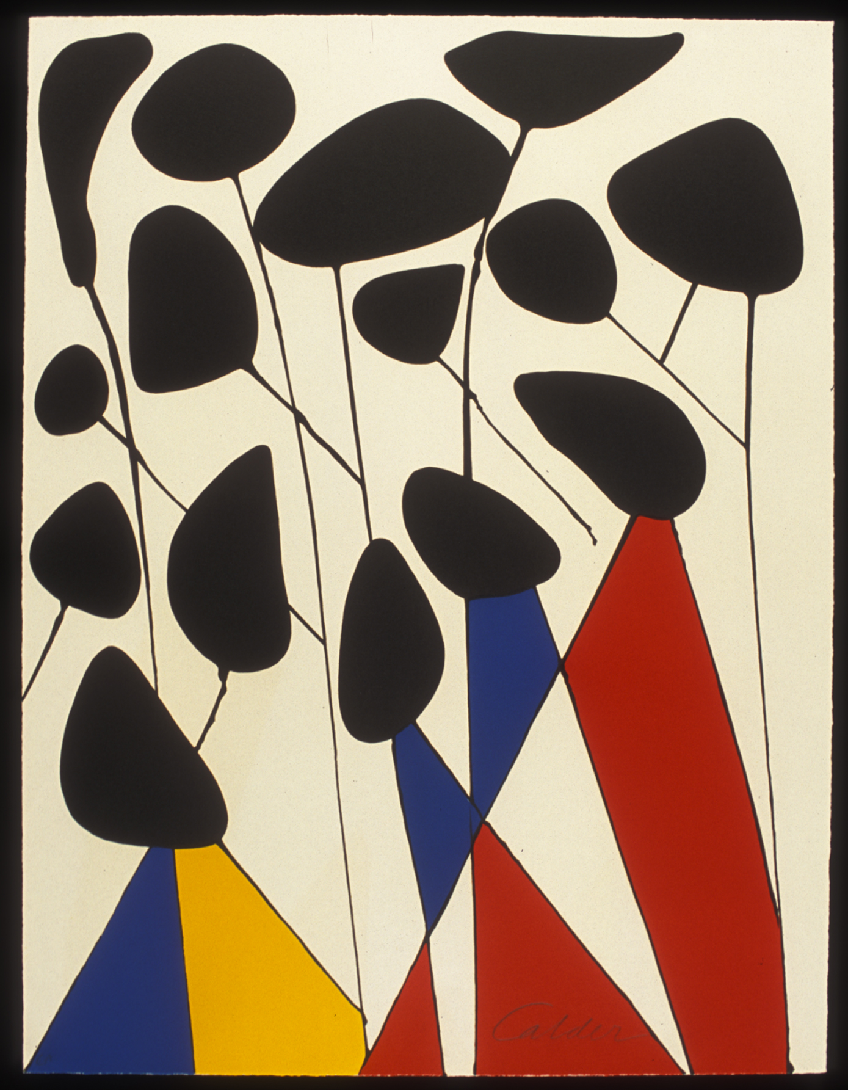
Untitled (Les Fleurs II), 1972
Alexander Calder
(American, 1898-1976)
Lithograph on Paper
H. 29.5 x W. 19.5 inches
Jordan Schnitzer Museum of Art, University of Oregon; The Elizabeth Cole Butler Graphic Arts Collection, Bequest to the Museum, 2017:4.2

Slide 8
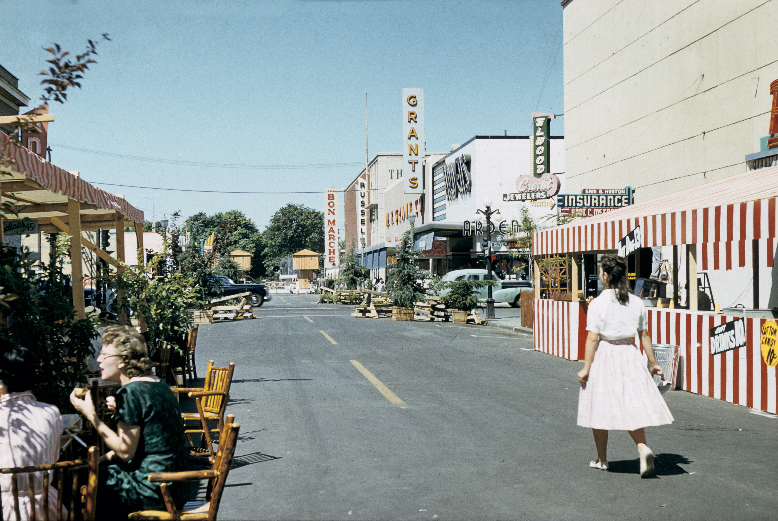
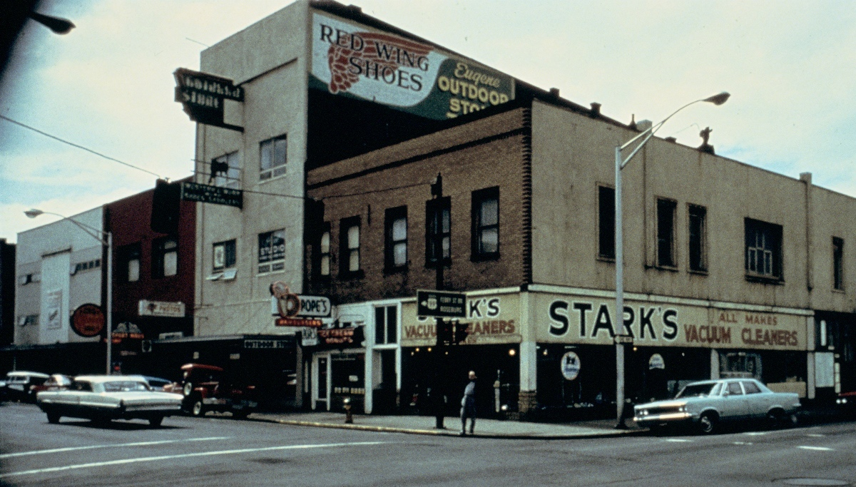
Street scenes in Eugene, Oregon in 1959 (top) and 1990 (bottom)
Top: Grants Department Store, Eugene Mall (Eugene, Oregon), 1959, Building Oregon, 711 AmO Eu43 157, Design Library, University of Oregon Libraries, Eugene, Oregon Bottom: Stark's Vacuum Cleaners, Eugene Outdoor Store (Eugene, Oregon), 1990, Building Oregon, eug1231, Design Library, University of Oregon Libraries, Eugene, Oregon

Slide 9
WHY RESTRICT ACCESS?

Slide 10
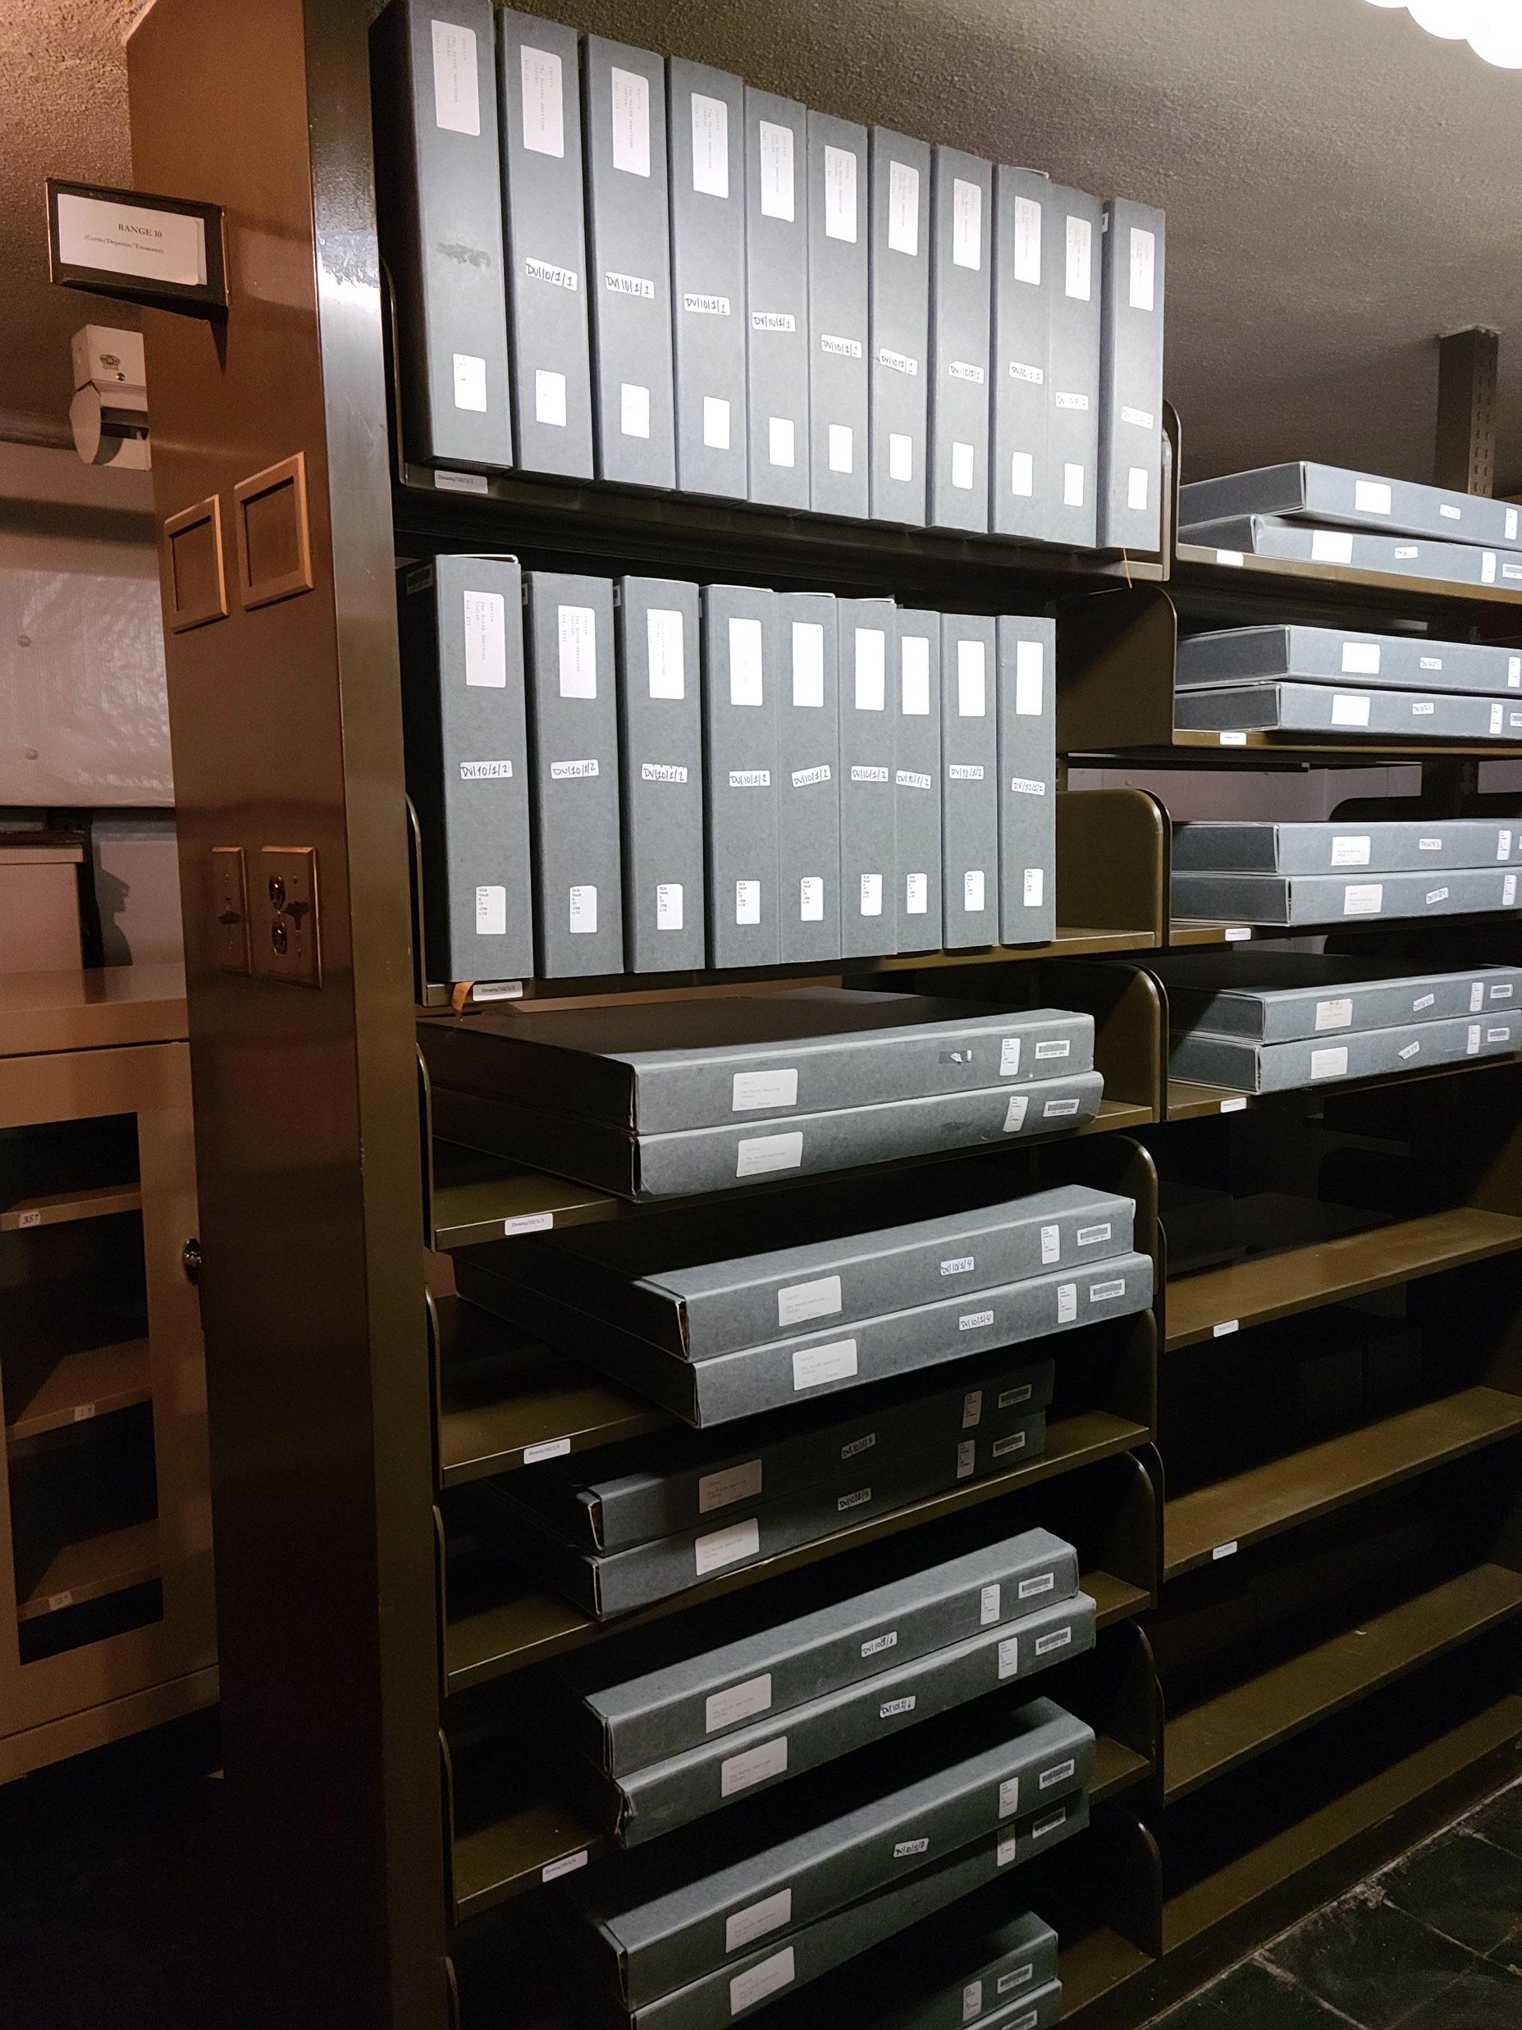
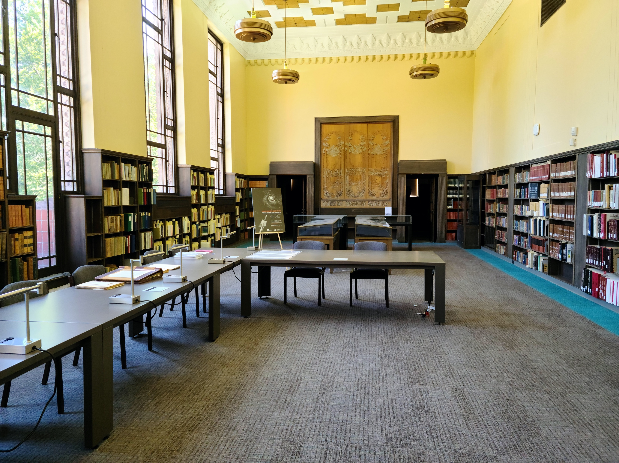
Courtesy of UO Libraries
Courtesy of UO Libraries

Slide 11
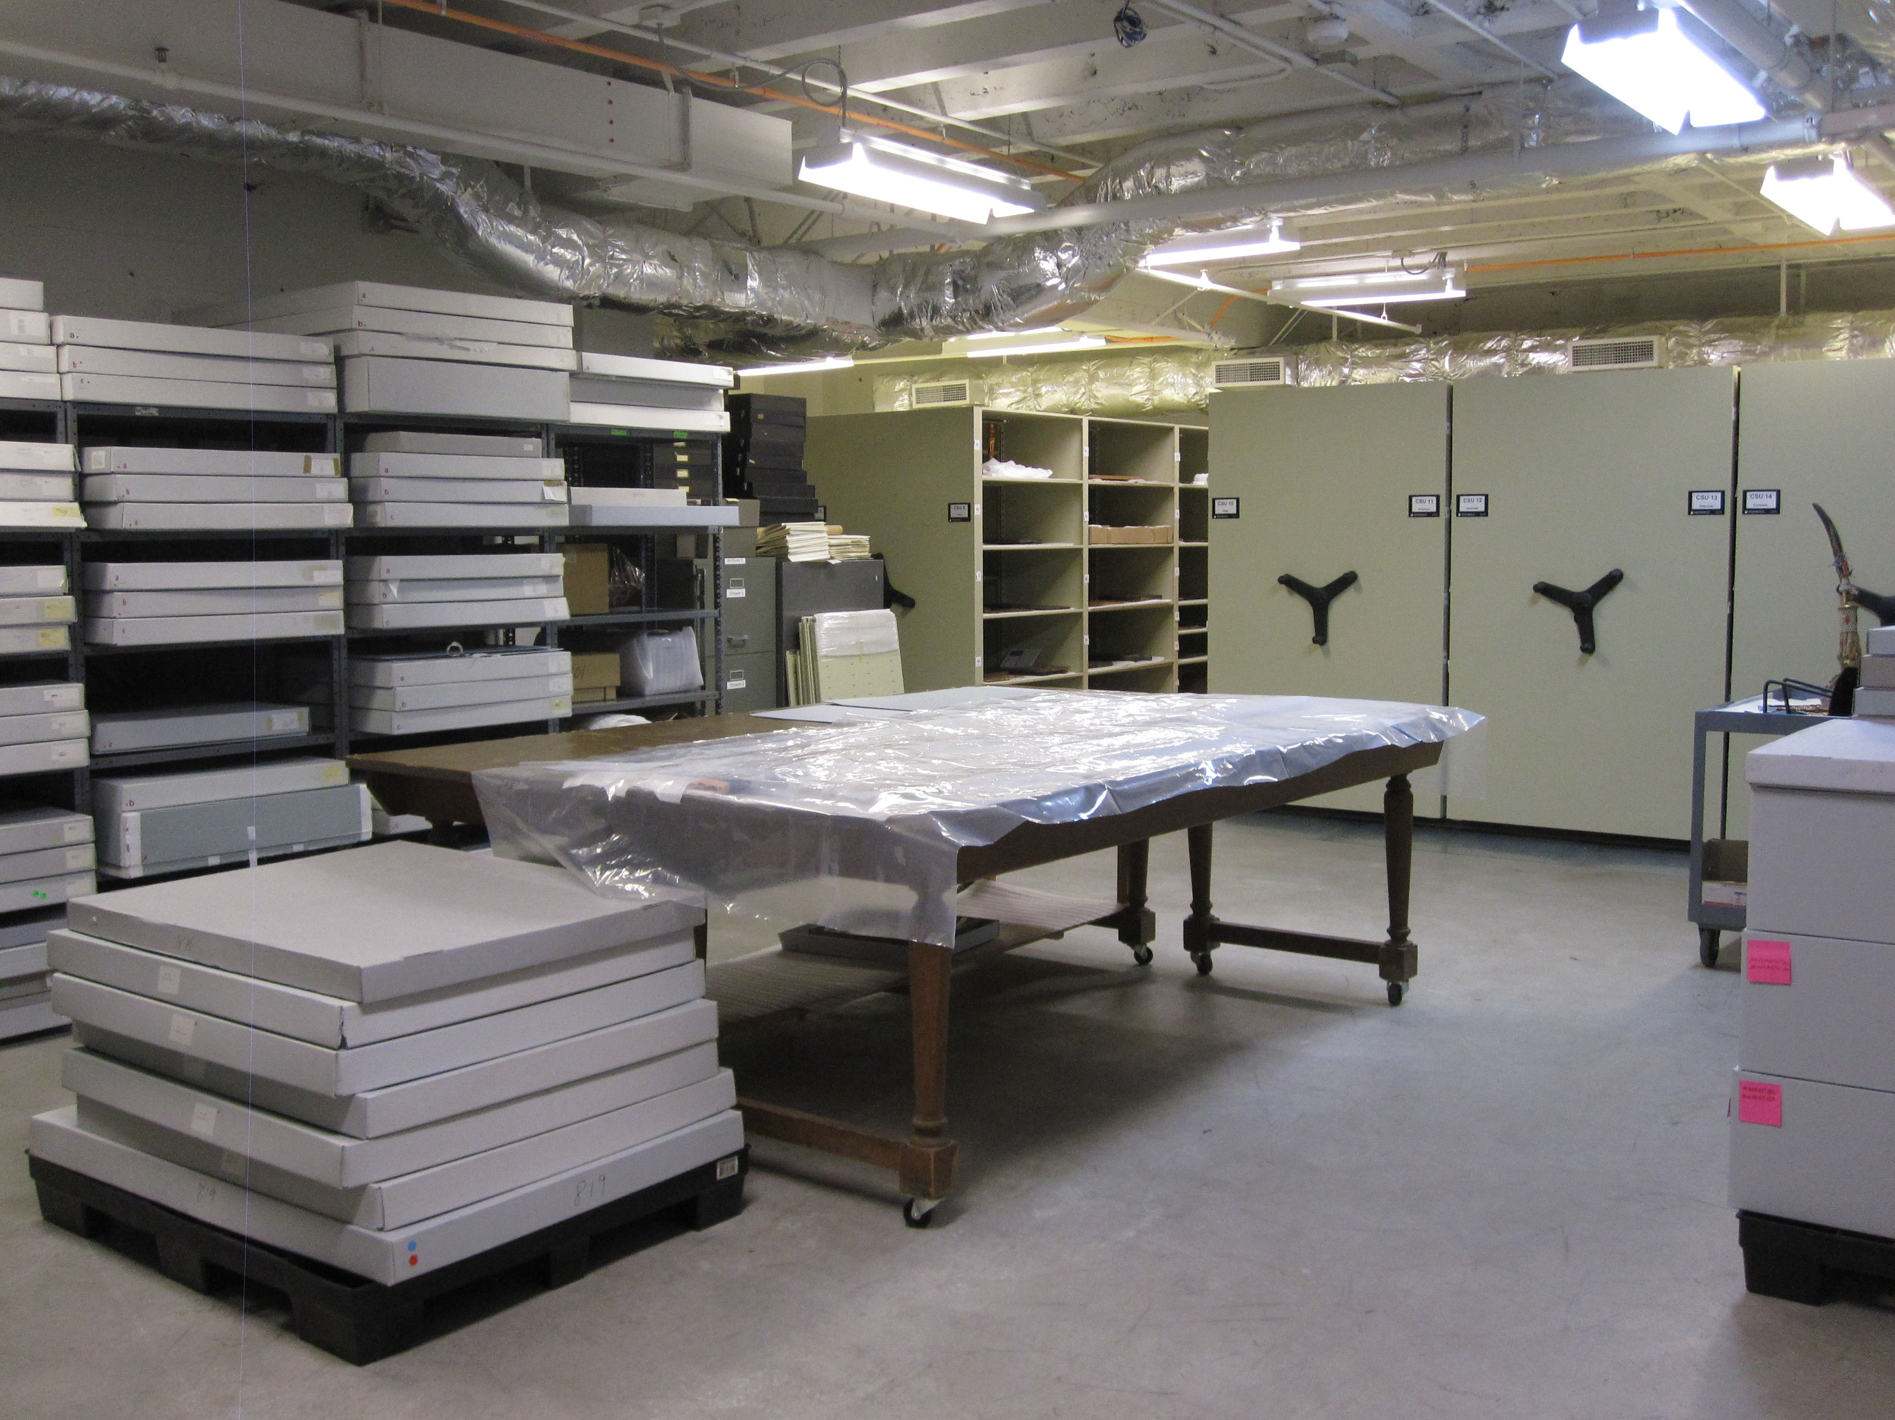
Courtesy of Jordan Schnitzer Museum of Art

Slide 12
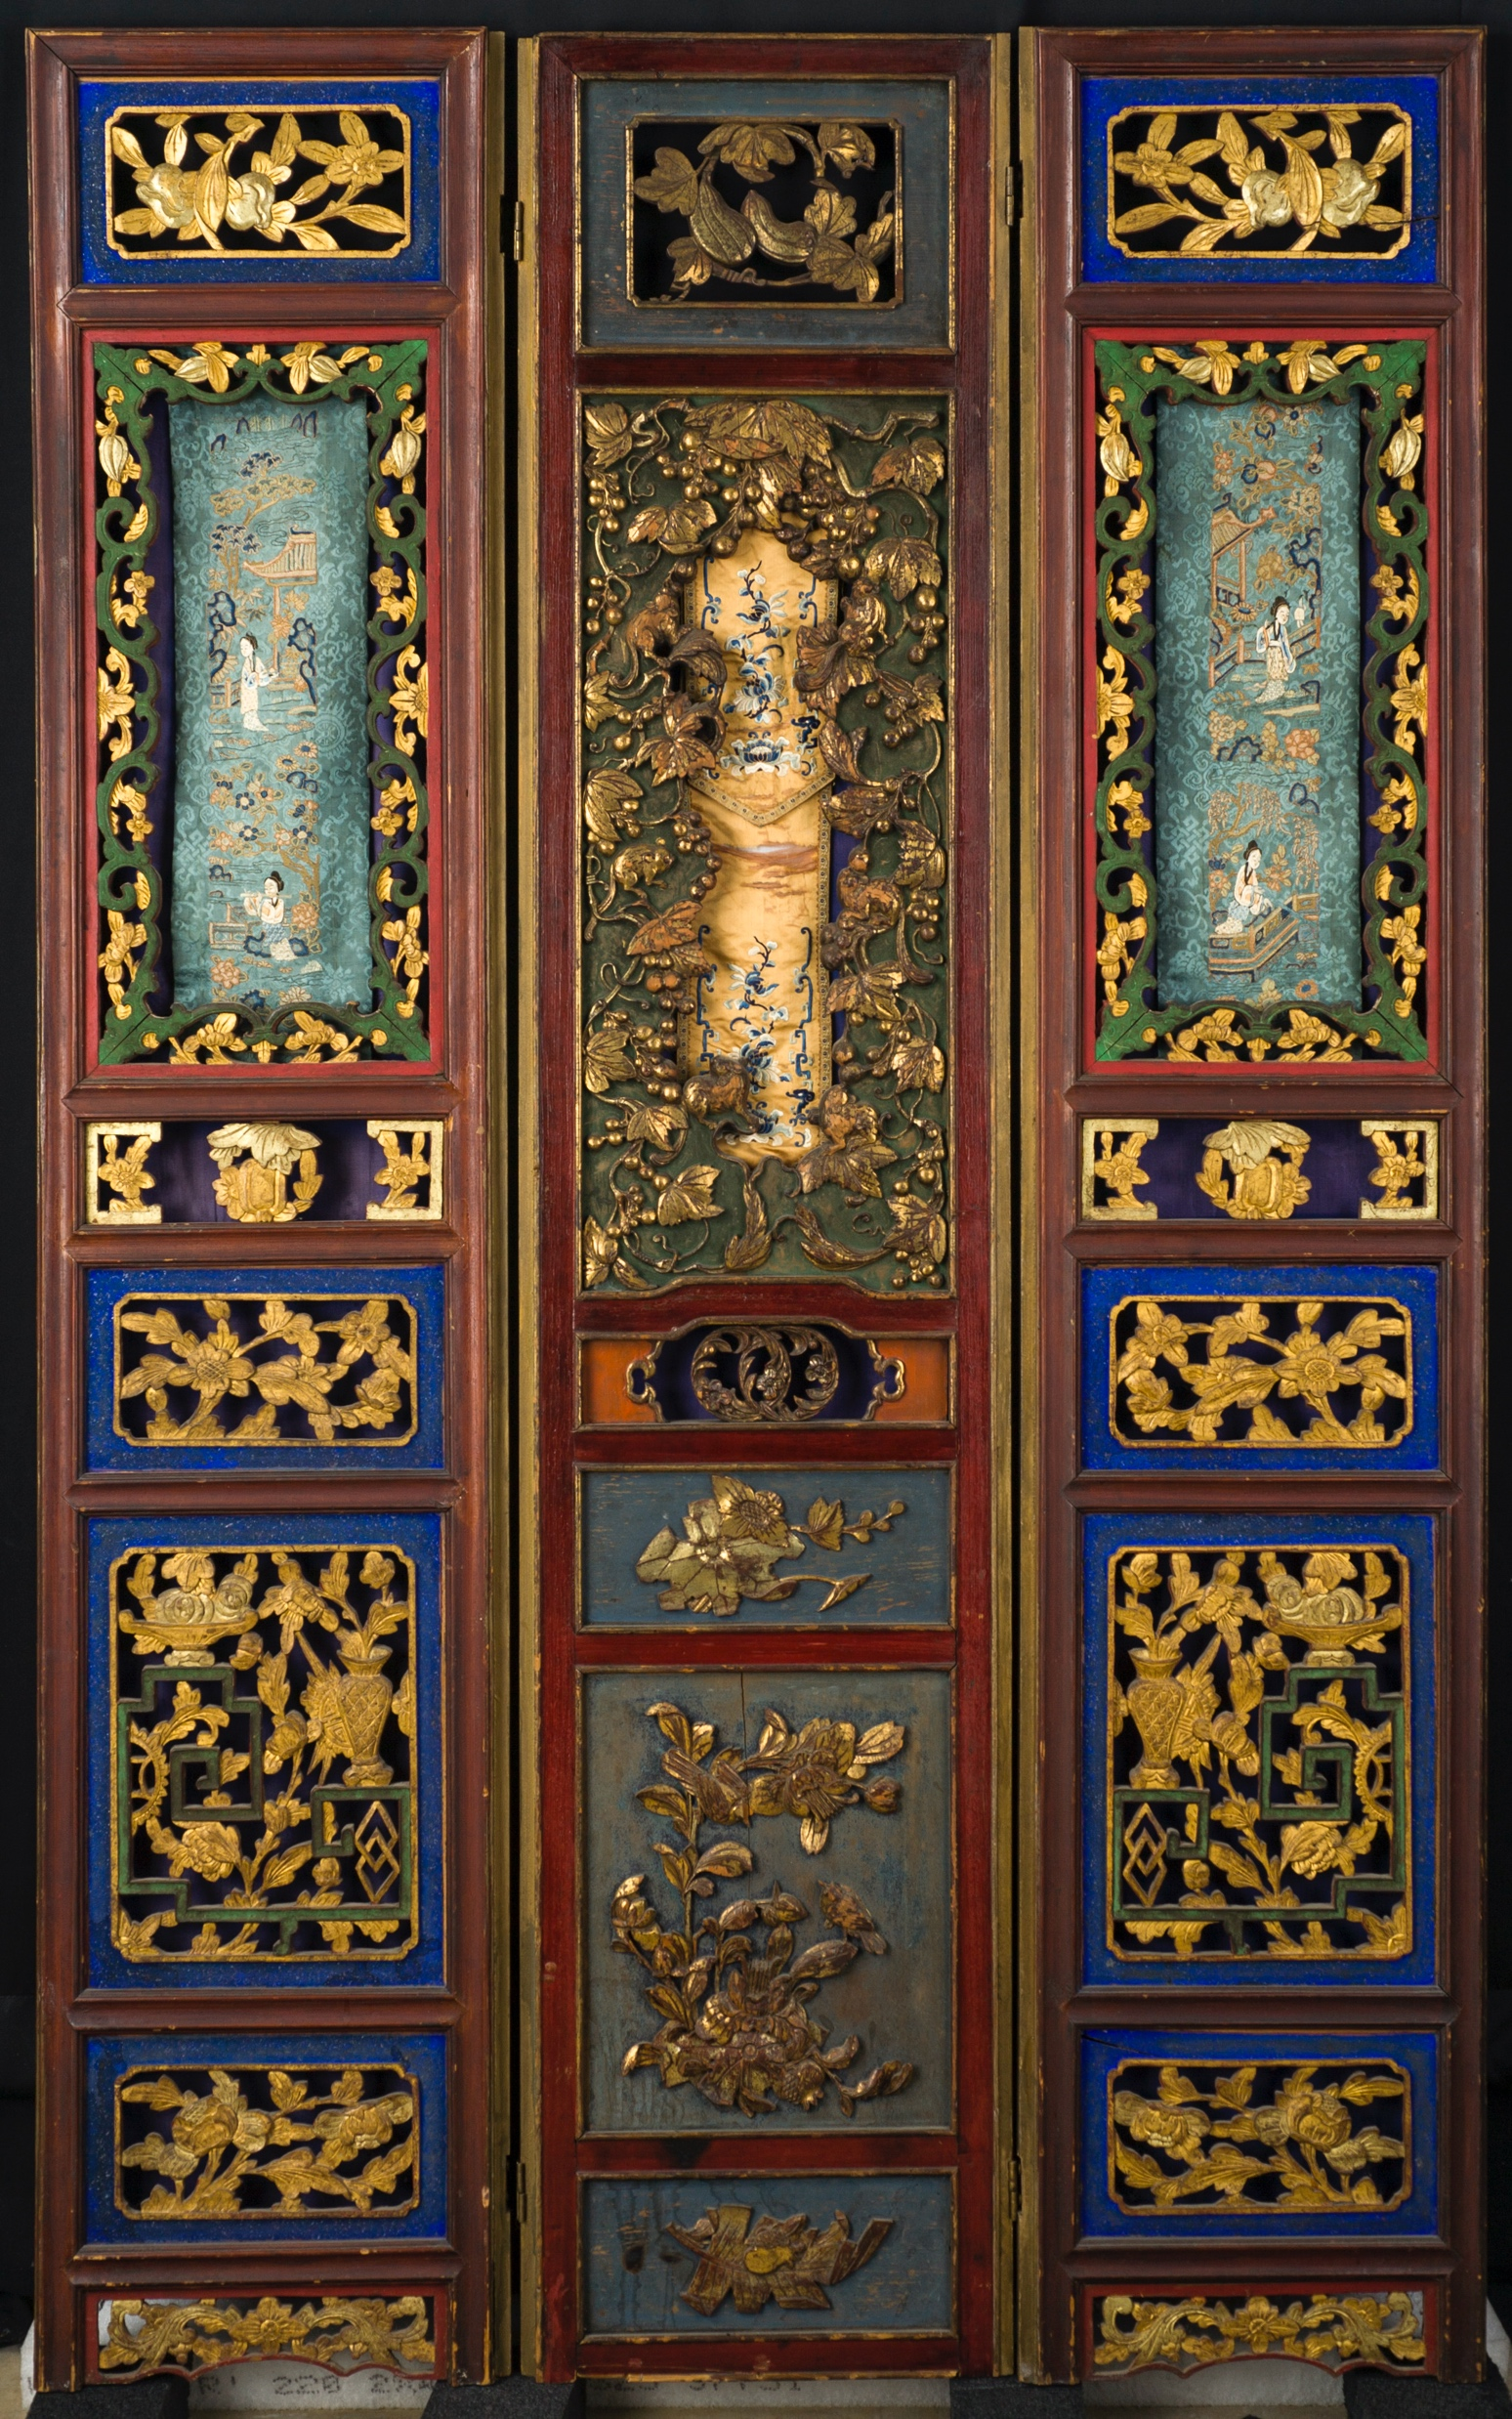
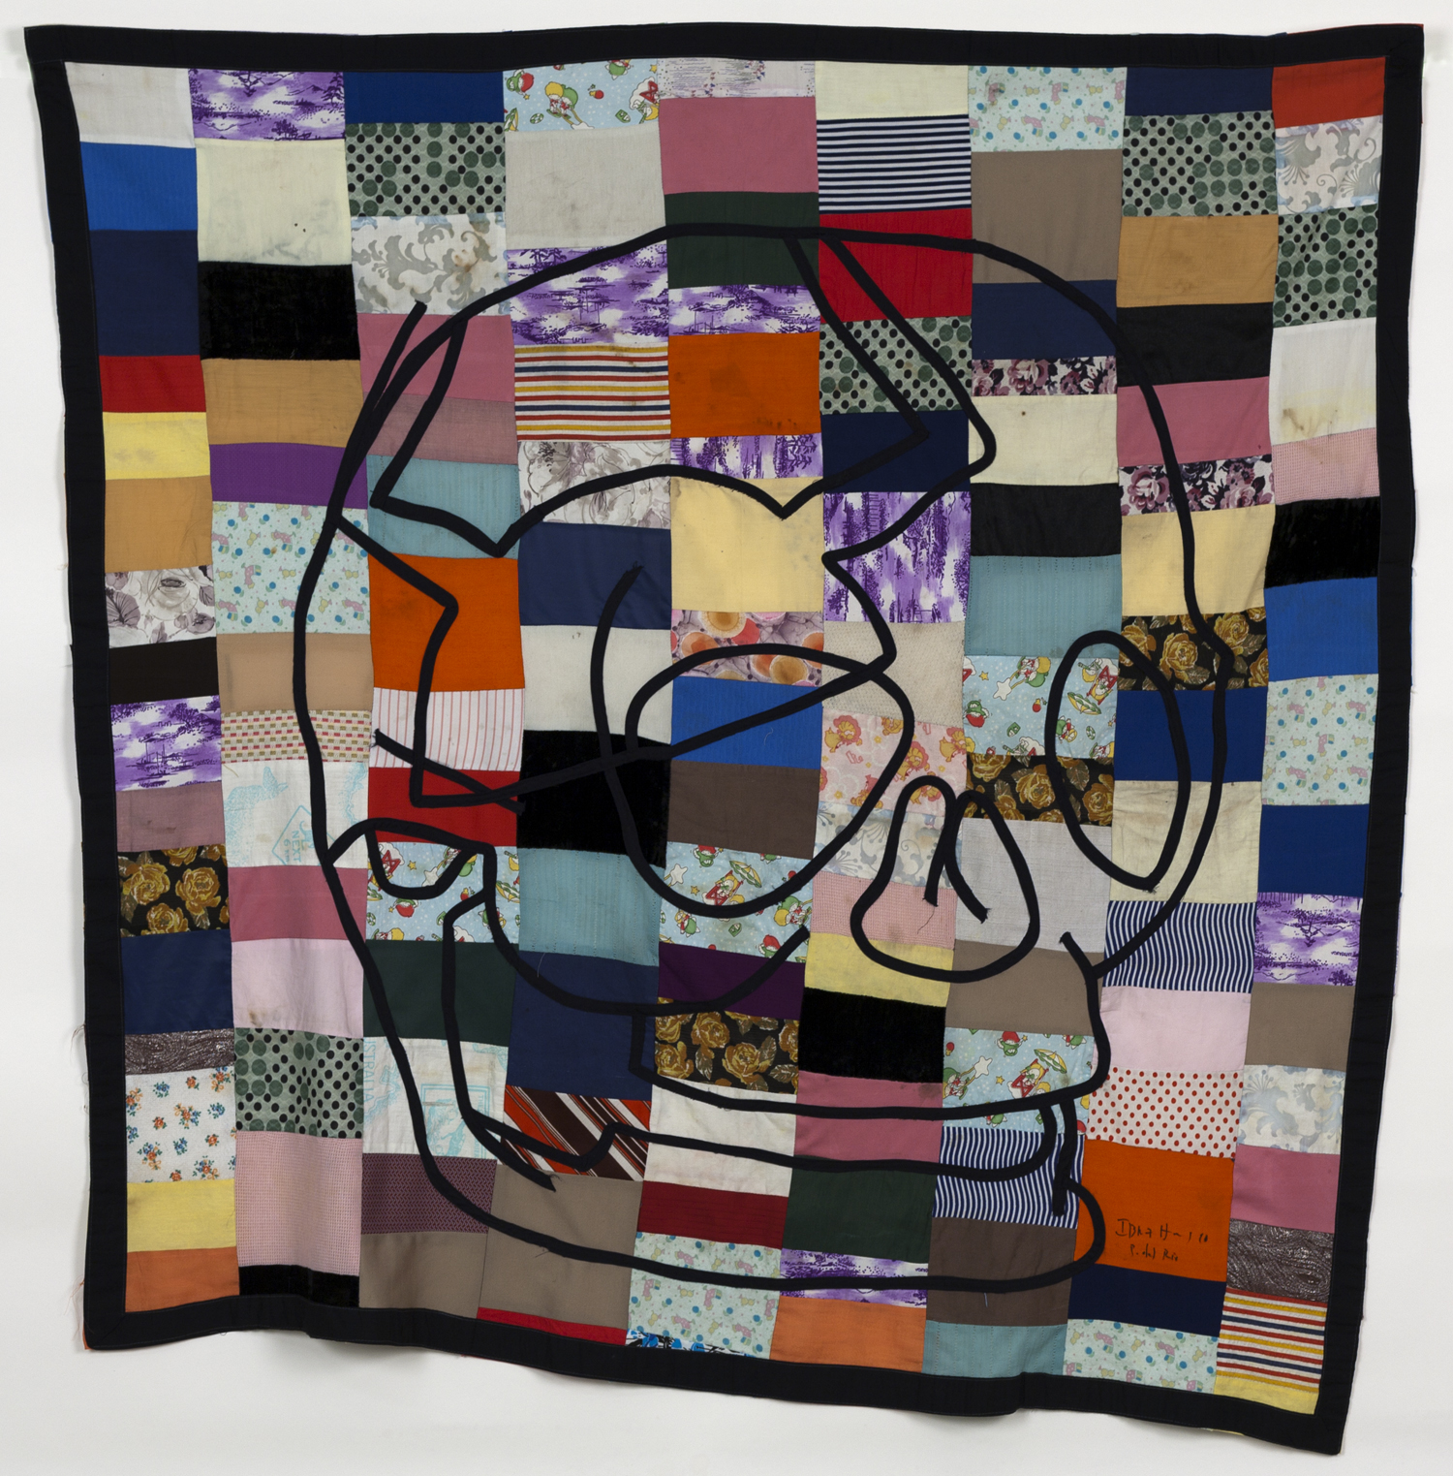
Wooden Screen with Floral Decoration and Inset Embroidered Panels, ca. 1875
H. 71-3/8 x W. 43-3/4 inches
(Detached) Three-panel folding screen (marriage) of carved, painted, lacquered and gilded wood with (unrelated) embroidered silk panels pinned behind openwork "frames”
H. 71-3/8 x W. 43-3/4 inches
Jordan Schnitzer Museum of Art, University of Oregon; Gift of Mrs. Robert Ogle honoring Alfred S. V. Carpenter, 1986.19
Miranda, Ibrahim
Sin titulo (Untitled), 1998 H. 54 x W. 56 inches
textile
H. 54 x W. 56 inches
Jordan Schnitzer Museum of Art, University of Oregon; Gift of Dr. and Mrs. Irwin R. Berman, 2008.11.4

Slide 13
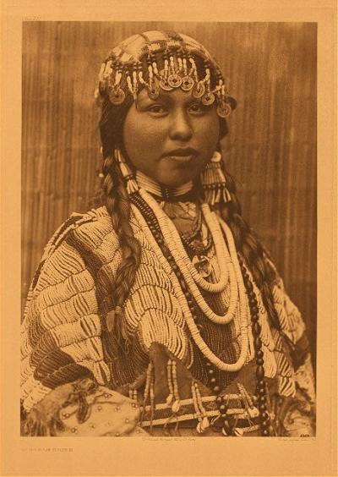
Notice on UO Library Website
We request that anyone interested in doing research on the original Curtis folios and quartos in Special Collections and University Archives first consult the reprint volumes in the Paulson Reading Room or the online images. If a researcher still finds it necessary to see the original photogravures, he or she must submit a written request describing the research project and need to use the originals. Please send this request to spcarref@uoregon.edu. Curatorial staff will review the request and work with the researcher.
Edward Curtis, Wishham Bride, no. 281, 1910, photogravure, from "The North American Indian"

Slide 14
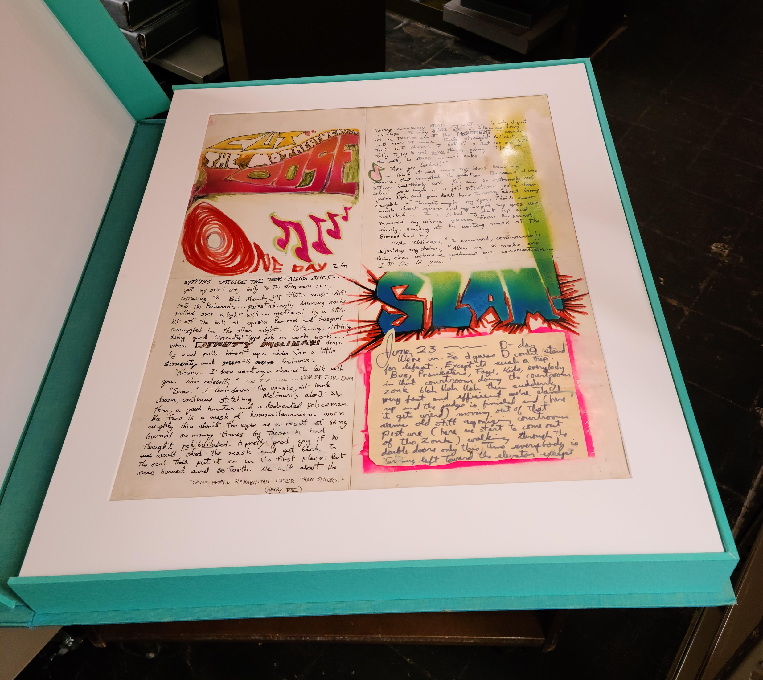
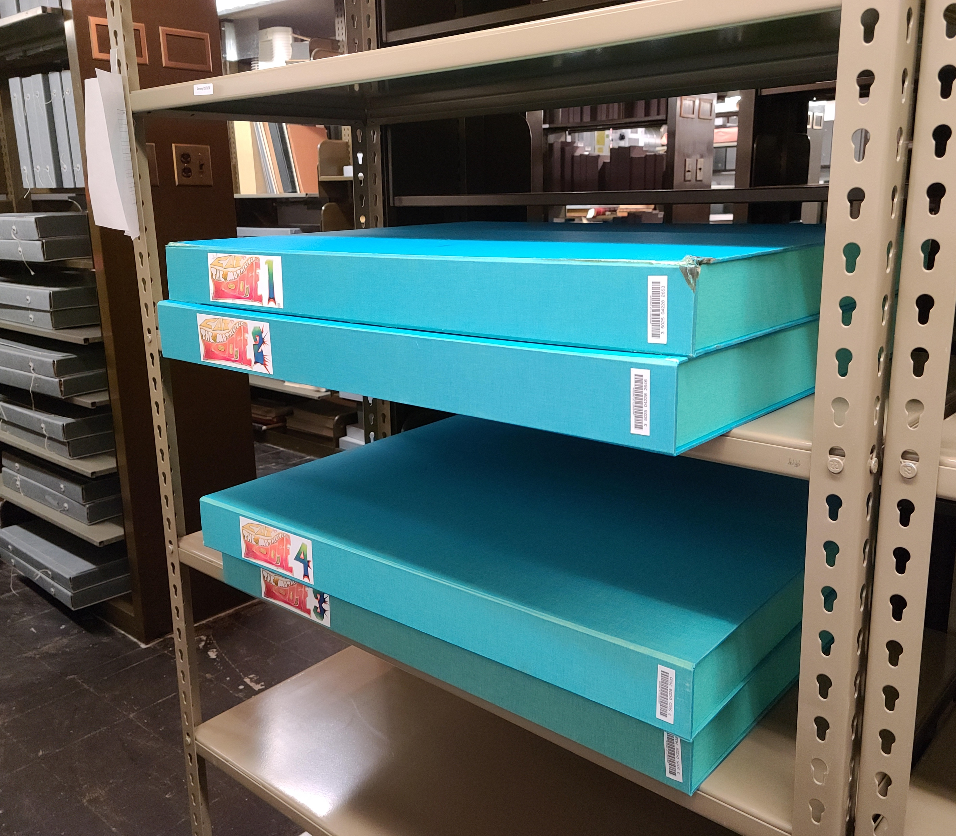
Courtesy of UO Libraries
Courtesy of UO Libraries

Slide 15
Discussion
Should anyone be allowed to see anything from the collections?
Should they be required to provide a reason for their interest?

Slide 16
CONNECTING COLLECTIONS

Slide 17
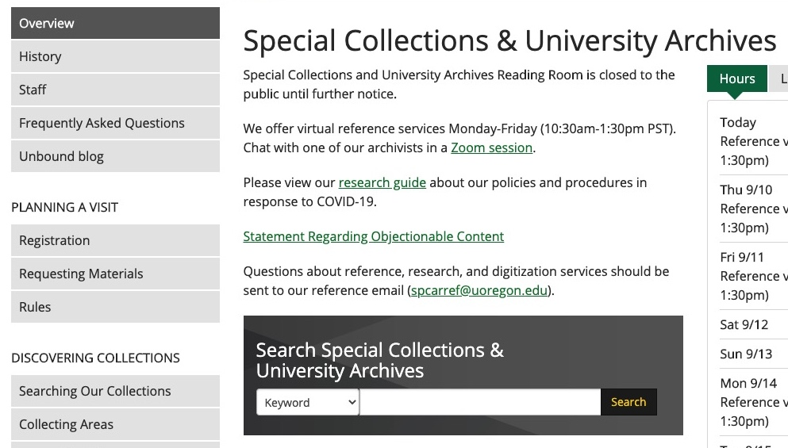
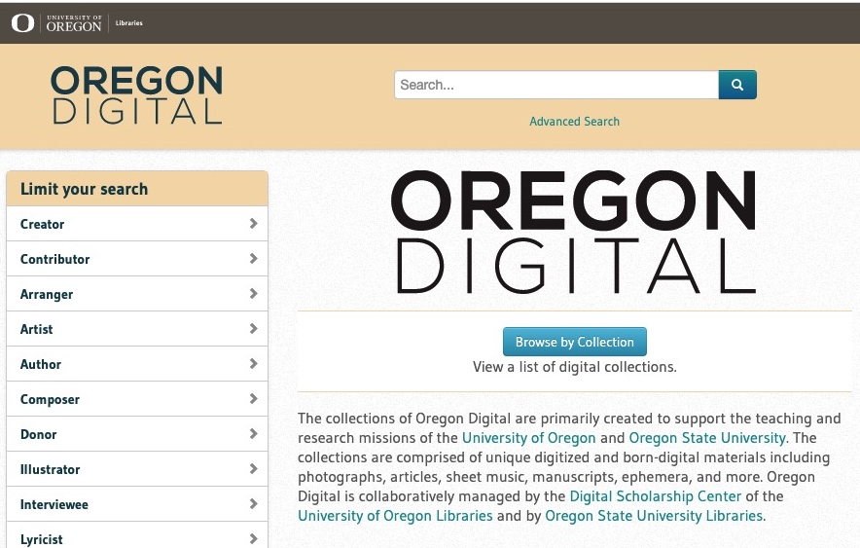
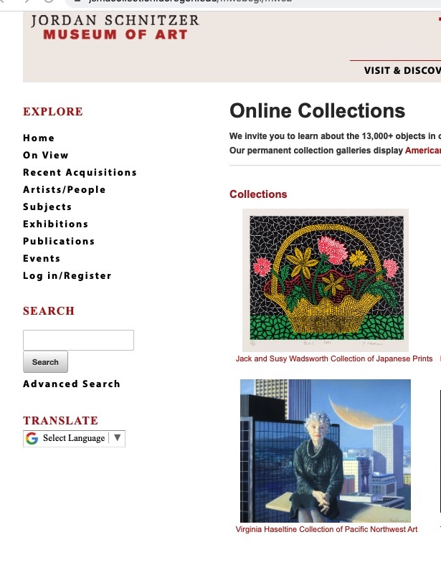

Slide 18
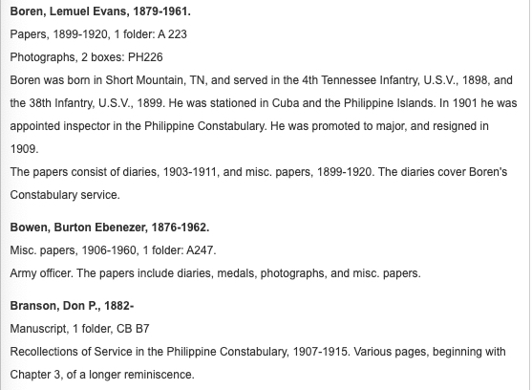
https://researchguides.uoregon.edu/scua-military-conflicts/philippine

Slide 19
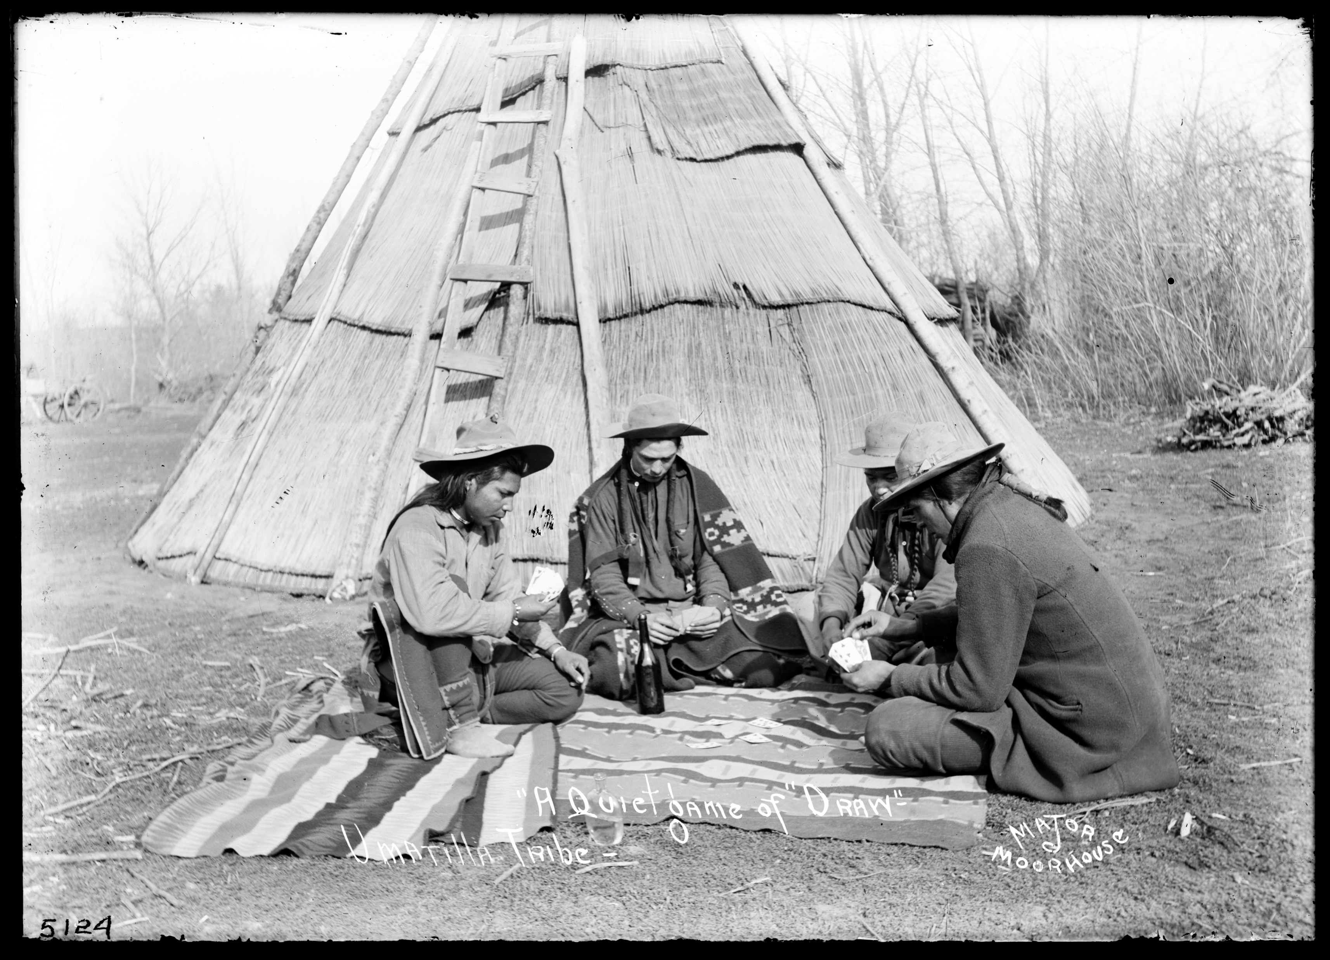
A Quiet Game Of Draw - Umatilla Tribe, 1900-1910
Moorhouse (Major Lee) Photographs, PH036 / A82, Box 210, Special Collections & University Archives, University of Oregon Libraries, Eugene, Oregon

Slide 20
Activity:
For each example collection housed by the Jordan Schnitzer Museum of Art and UO Libraries Special Collections, identify an audience that might be interested in the collection and propose a method that might be used to raise awareness of the collection among that group.

Slide 21
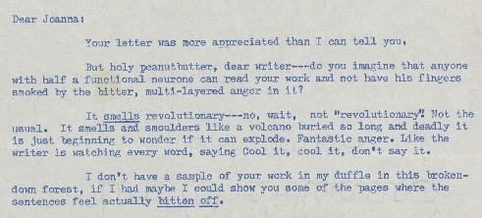
FEMINIST SCIENCE FICTION
The UO Libraries Special Collections holds the papers of many prominent feminist science fiction writers, including Ursula Le Guin, Joanna Russ, James Tiptree, Jr. (Alice Sheldon), Kate Wilhelm, Sally Gearhart, Vonda McIntyre, and more.
Tiptree, James Jr. [Sheldon, Alice] [f02] [004], 1973-08/1973-09,
Joanna Russ papers, 1968-1989, Coll 261, Box 10, Folder 26, Special Collections & University Archives, University of Oregon Libraries, Eugene, Oregon

Slide 22
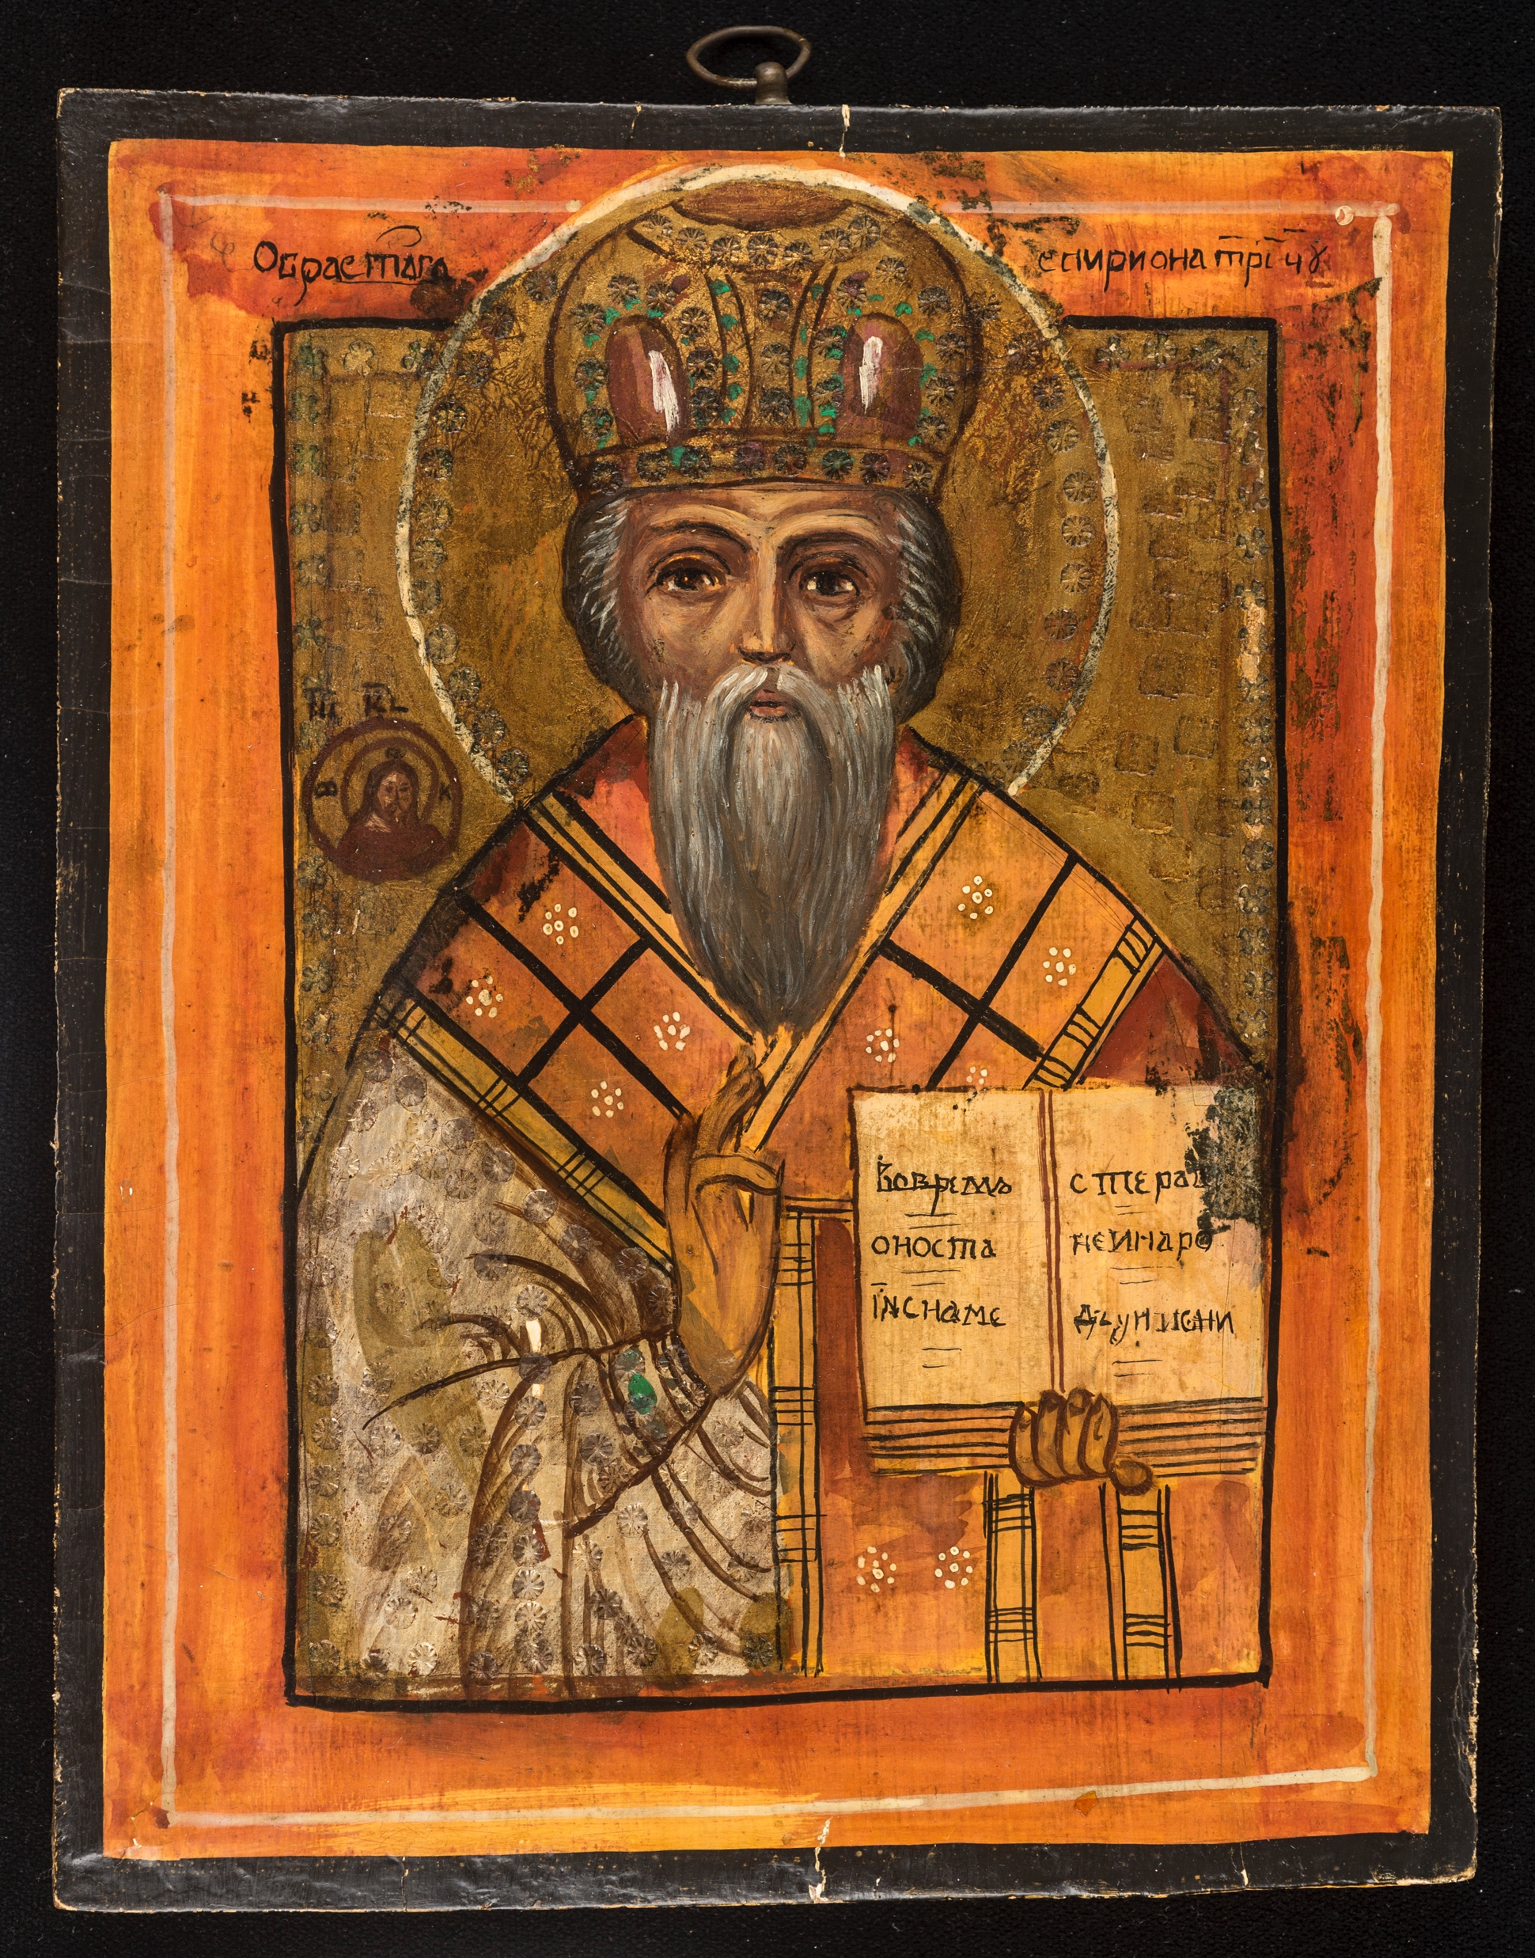
RUSSIAN ICONS
The Jordan Schnitzer Museum of Art holds a collection of Russian icons and religious objects such as crucifixes that date from the 15th through the 20th century.
Saint Nicholas the Wonderworker 20th century
Acrylic on wood panel
12 - 1/4 x 9-3/4 inches
Jordan Schnitzer Museum of Art, University of Oregon; Gift of Jacob B. Kolliner, 1987:60

Slide 23
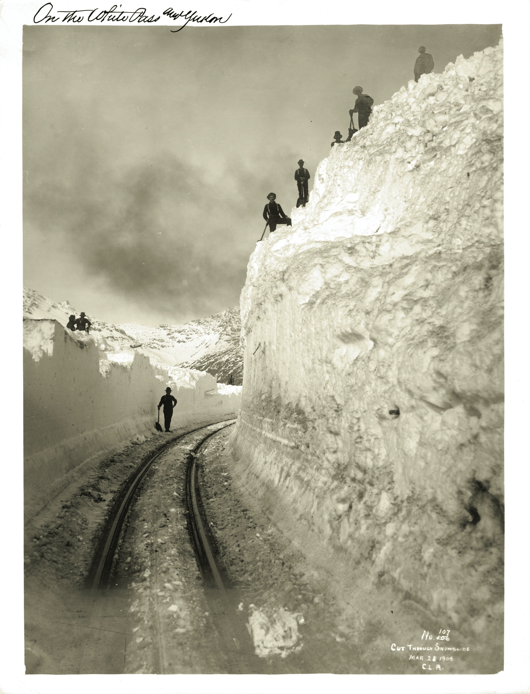
ALASKA AND THE ALASKAN GOLD RUSH
The UO Libraries Special Collections holds multiple collections relating to Alaska, with an emphasis on the Alaskan Gold Rush of the late 1800s. Collections include photographs, journals, business records, and correspondence.
PH001_0827 C.L. Andrews photographs, 1904-03-28
C. L. Andrews photographs, 1880s-1948, PH001, Special Collections & University Archives, University of Oregon Libraries, Eugene, Oregon

Slide 24
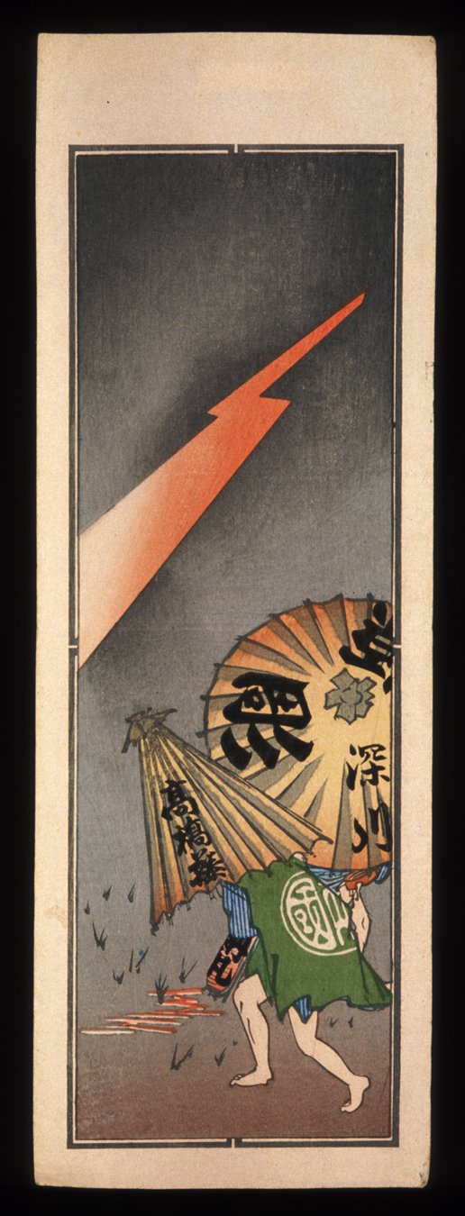
NŌSATSU JAPANESE VOTIVE SLIPS
The University of Oregon is home to a large collection of nōsatsu dating from the 1850s through the 1930s. Originally used for religious observance in shrines and temples, in the late 19th century they became popular as items to exchange and collect.
Nosatsu of men in thunder storm
19th-early 20th century
Woodblock-printed nôsatsu (納札) or senjafuda (千社札) in itchô format; ink and color on paper, Jordan Schnitzer Museum of Art, University of Oregon; Gift of Frederick Starr Estate, 1964:3.23.131

Slide 25
Closing Reflection:
Why is it important for museums and library special collections to ensure that collections are accessible to a broad range of stakeholders?

Slide 26
Rights
Special Collections and University Archives, University of Oregon
For information about reproduction and use of copyrighted works, please email spcarref@uoregon.edu
Works In Copyright
(4) Black Student Union memo: Grievances and Demands of Black Students on the University of Oregon.
(6) Ruth Mountaingrove, [Untitled, Call309_A22_P3_0009]
(21) Tiptree, James Jr. [Sheldon, Alice] [f02] [004]
Design Library, University of Oregon Libraries
For information about reproduction and use, please contact Oregon Digital at https://oregondigital.org/contact
Works In Copyright
(8) Grants Department Store, Eugene Mall (Eugene, Oregon)
(8) Stark's Vacuum Cleaners, Eugene Outdoor Store (Eugene, Oregon)
Jordan Schnitzer Museum of Art, University of Oregon
For information about reproduction and use of copyrighted works, please email jsmith3@uoregon.edu
Works In Copyright
(7) Alexander Calder, [Untitled (Les Fleurs II), 1972]
(12) Miranda, Ibrahim, [Sin titulo (Untitled), 1998]

Slide 27
Sponsors
The Uniting Collections curriculum is the result of a collaboration between the University of Oregon Libraries and the Jordan Schnitzer Museum of Art, with support from The Andrew W. Mellon Foundation.
Licensing
This work is licensed under a Creative Commons Attribution-NonCommercial-Sharealike 4.0 International License to Daphne Gallagher and the University of Oregon, 2020.
This work may be adapted and reused by educators in schools, museums, libraries or any other non-profit context. You are encouraged to adapt the content to your institution. If you have any questions about your use of this resource, please contact Daphne Gallagher (daphne@uoregon.edu)
Individual works included in the PowerPoint may be under copyright or separate license. Please refer to the Rights slide(s) for more information.

