Slide 1
UNITED COLLECTIONS
Open Resources for Teaching Special and Museum Collections

Slide 2
BUILDING COLLECTIONS
What do Museums and Libraries Collect?

Slide 3
Group Brainstorm
Why do museums and special collections need to be selective in what they choose to collect?

Slide 4
HISTORY SHAPES COLLECTIONS

Slide 5
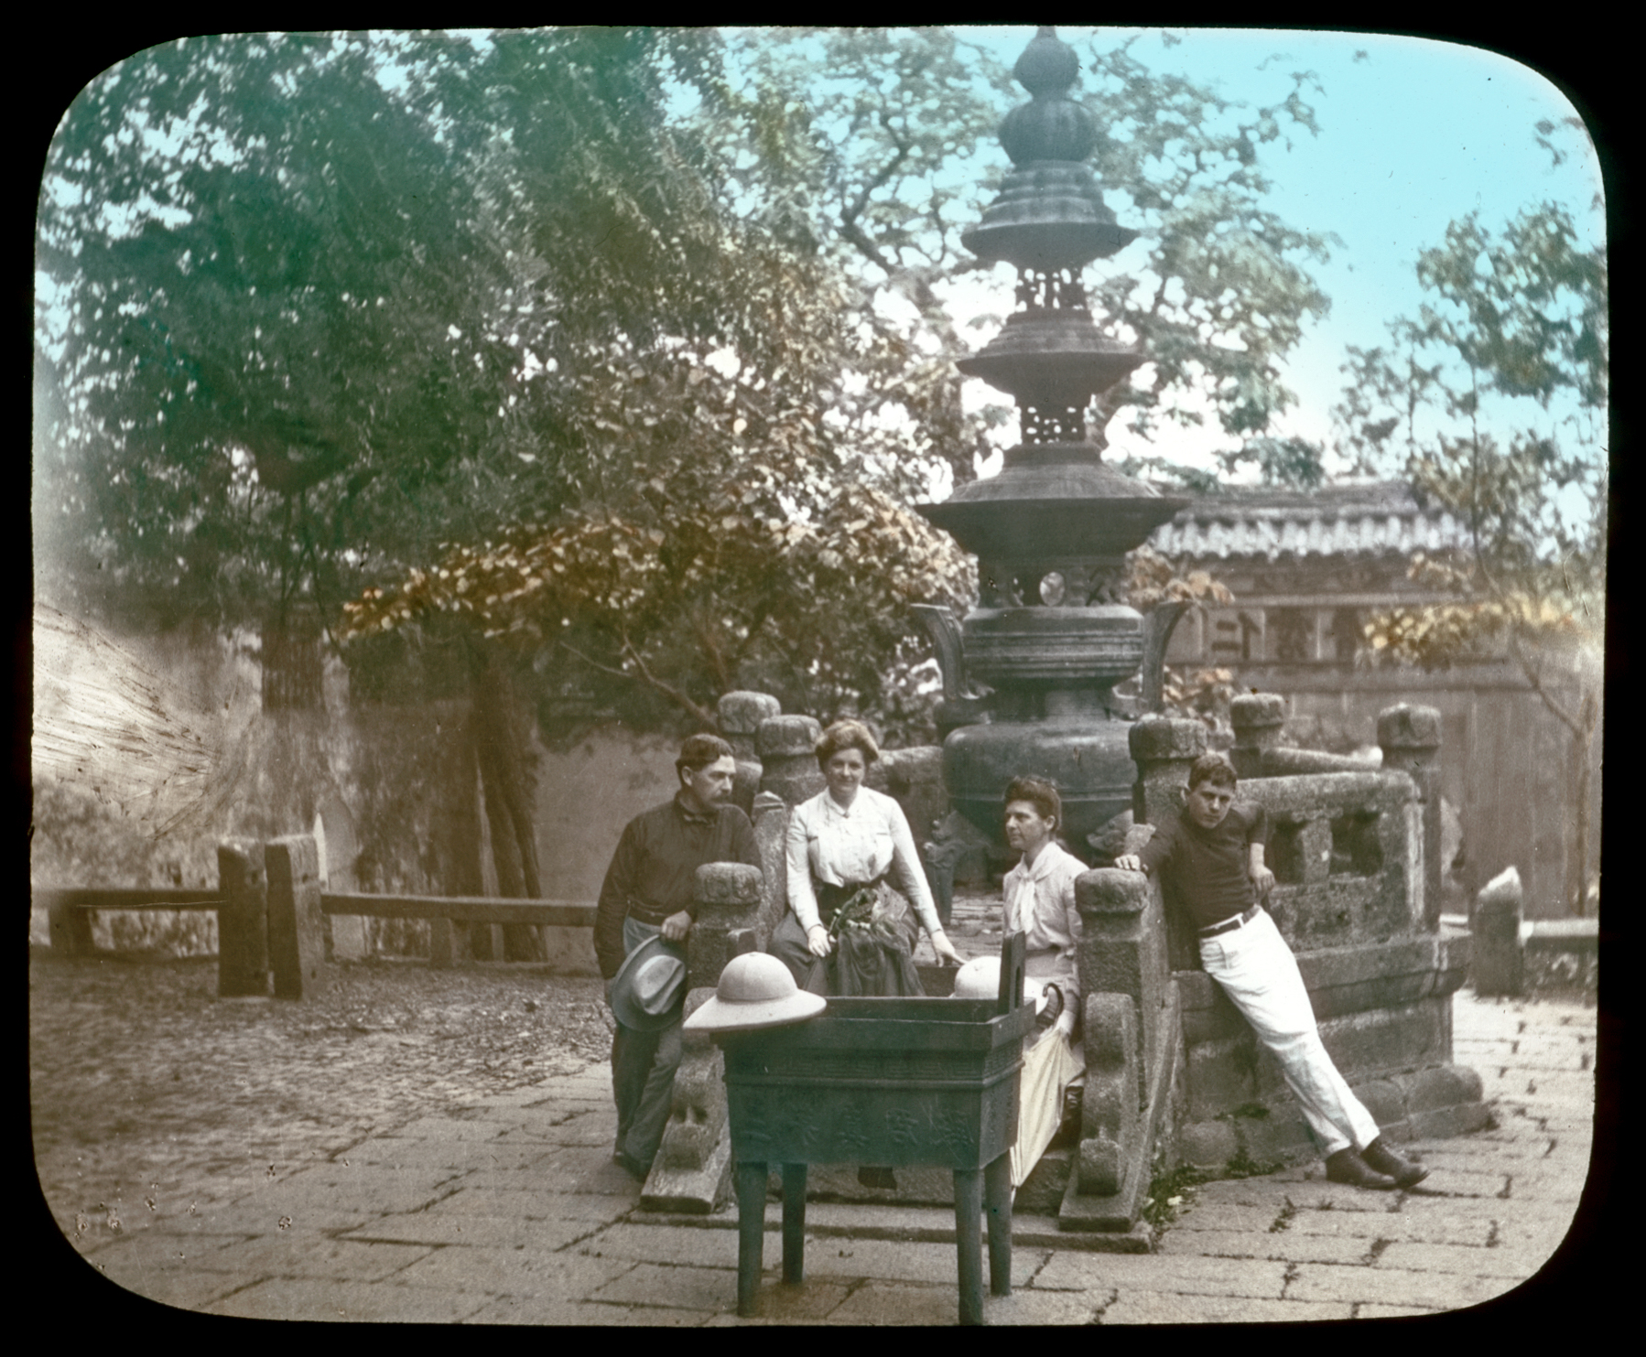
University of Oregon Museum of Fine Art
Founded 1933
From left: Murray Warner, Gertrude Bass Warner, Mrs. Epperly, and Sam Warner
PH014_90-19 Gertrude Bass Warner photographs, 1910/1929,
Gertrude Bass Warner (1863-1951) photographs, PH014, Special Collections and University Archives, University of Oregon Libraries, Eugene, Oregon.

Slide 6
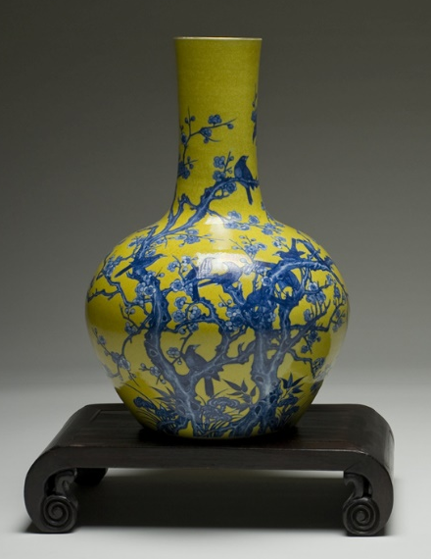
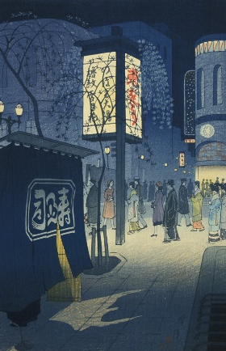
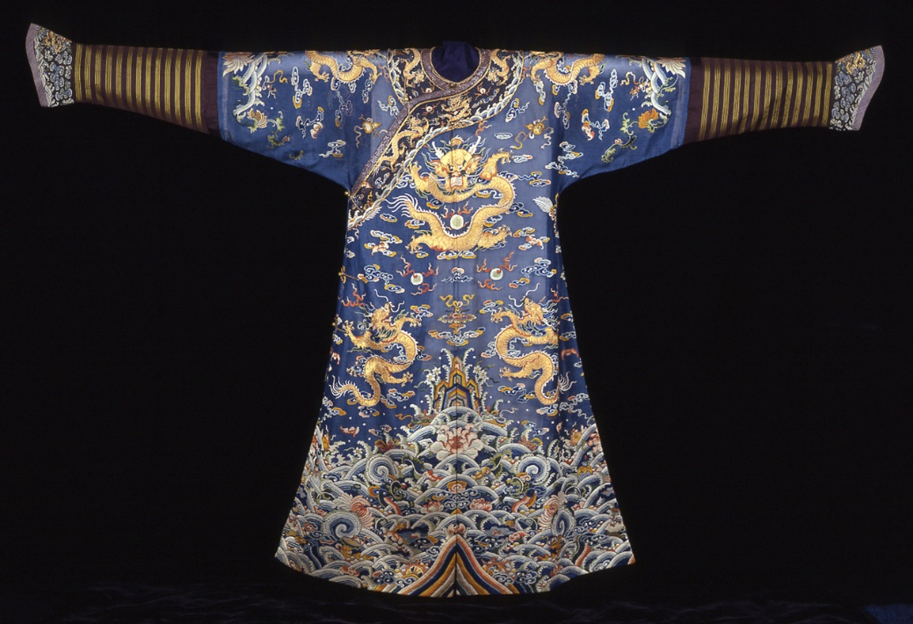
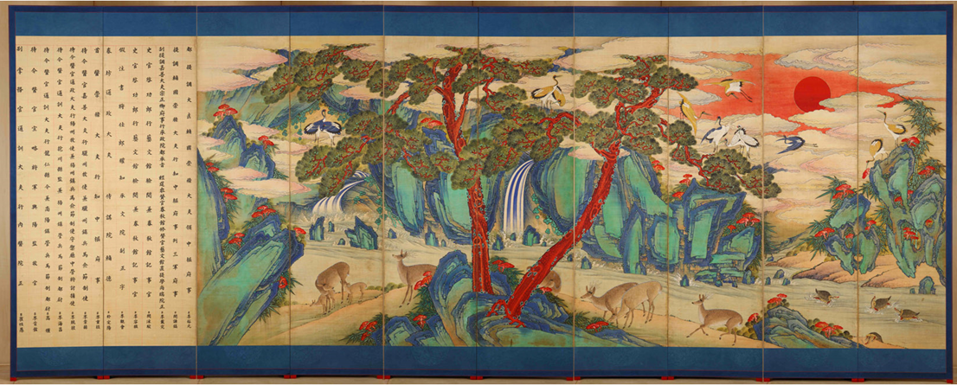
Selected Works from the Gertrude Bass Warner Collection

Slide 7
As published in the 1934 University of Oregon Yearbook Oregana XXVI, p. 165.

Slide 8
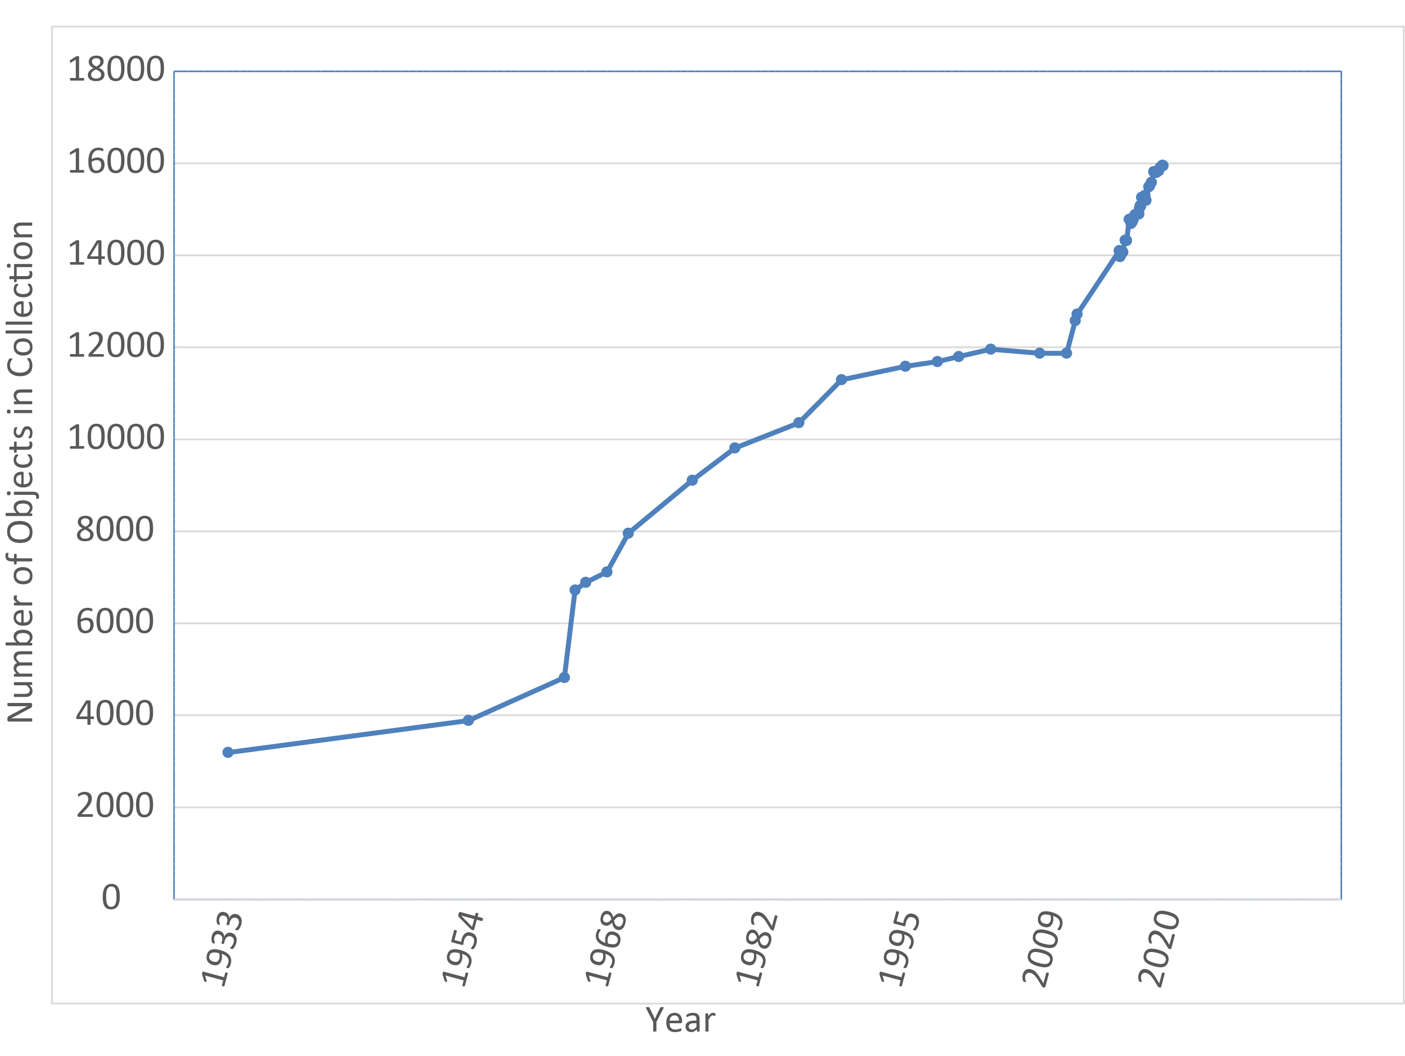

Slide 9
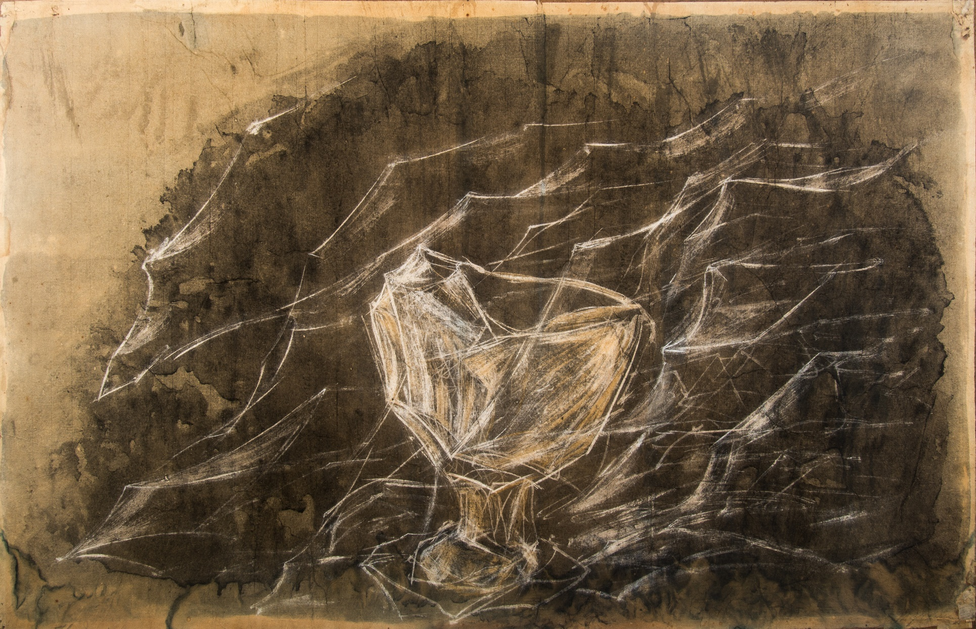
Journey III, circa 1943
Morris Graves
(American, 1910-2001)
Watercolor and gouache on paper, H. 19 x W. 29-1/2 inches
Jordan Schnitzer Museum of Art, University of Oregon; Virginia Haseltine Collection of Pacific Northwest Art, 1975:3.7

Slide 10
Questions
What are some of the positive impacts that donors and patrons can have on museums and libraries?
Why do you think the UO Museum of Art followed Virginia Haseltine’s encouragement to start collecting Pacific Northwest artists more actively?
What types of factors should a museum or library consider when approached by a donor who wishes to donate a large collection that would take the institution in a new direction?
How can museums and libraries enable input from stakeholders who are not able to donate to shape their collections?
Why is it important for museums and libraries to seek out these voices?

Slide 12
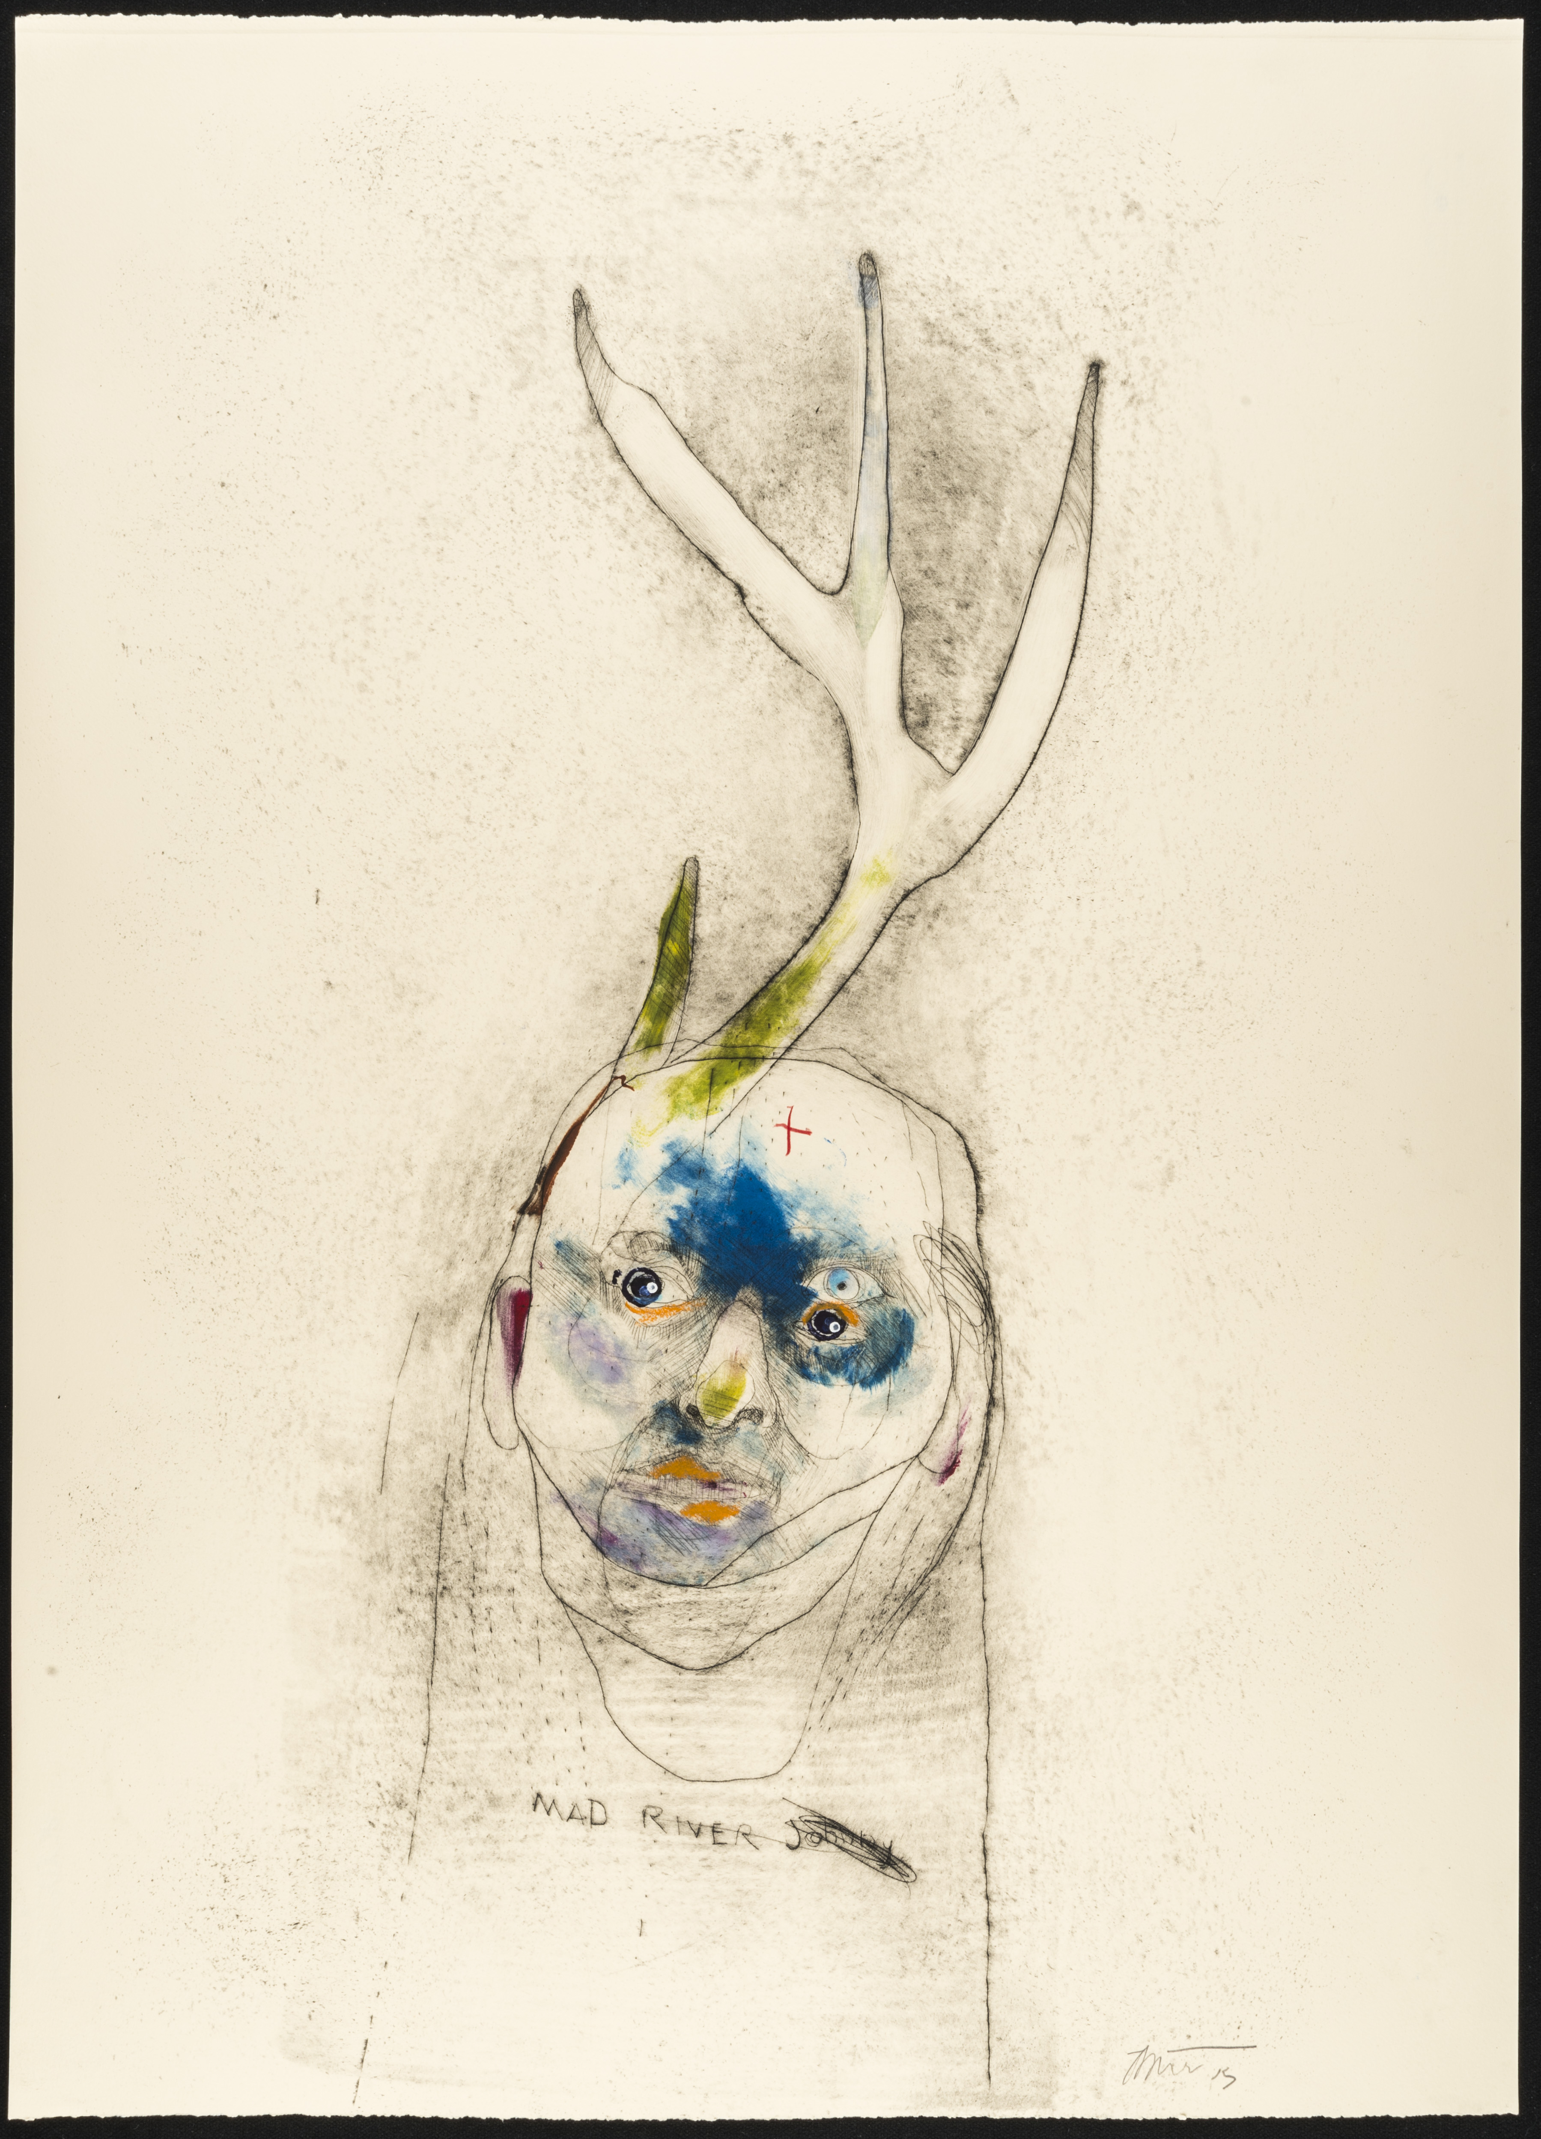
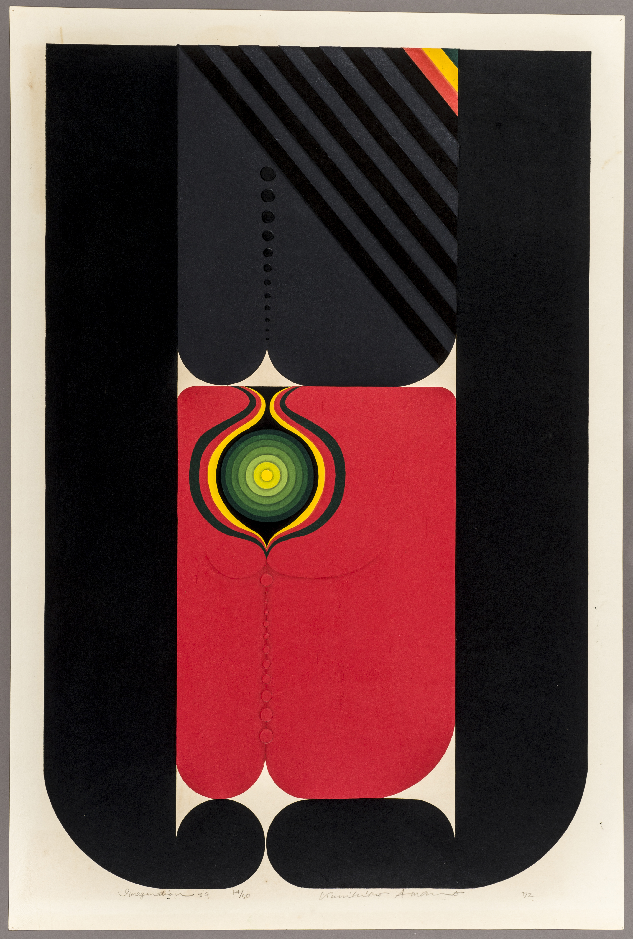
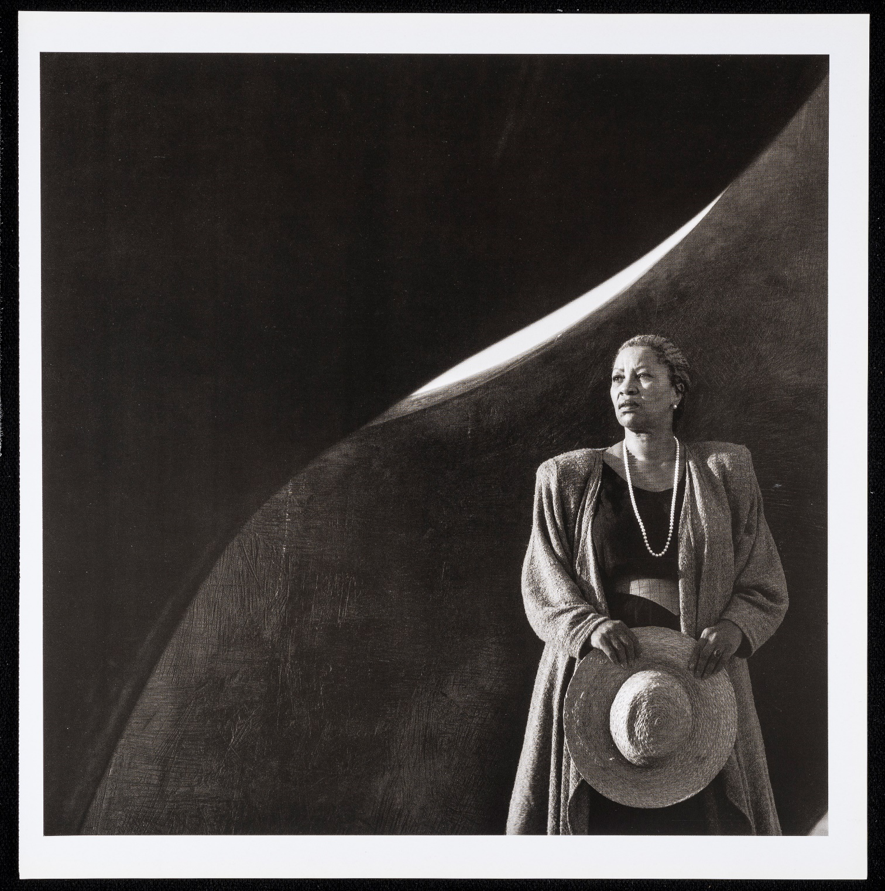
Mad River Johnny VII, 2015
Rick Bartow
American/Native American [Wiyot and Yurok], 1946-2016
Combination monotype, drypoint, and chine-collé
H. 30 x W. 22 inches
Jordan Schnitzer Museum of Art, University of Oregon; Gift of Rick Bartow. 2015:23.8
Toni Morrison, negative, ca. 1986-7; printed, ca. 1989
Brian Lanker
American, 1947-2011
Gelatin silver print
H. 36 x W. 36 inches
Jordan Schnitzer Museum of Art, University of Oregon; Gift of the Brian Lanker Archive and the Lanker family, 2015:18.69
Imagination 39, 1972
AMANO Kunihiro
(Japanese, b. 1929)
Woodblock print, ink and color on paper
H. 36-1/2 x W. 24-1/2 inches
Jordan Schnitzer Museum of Art, University of Oregon; Gift of the Jack and Susy Wadsworth Collection of Japanese Prints, 2012:7.4

Slide 13
NEW COLLECTING AREAS

Slide 14
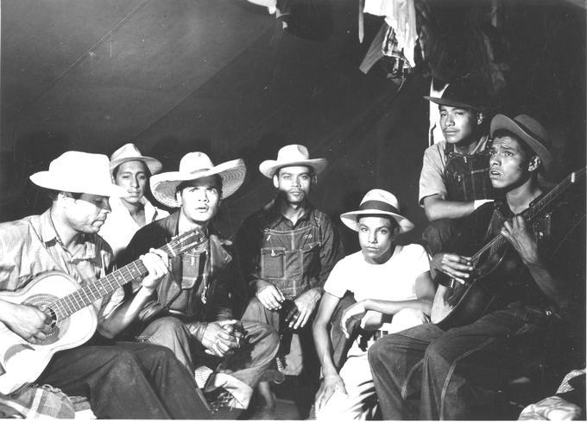
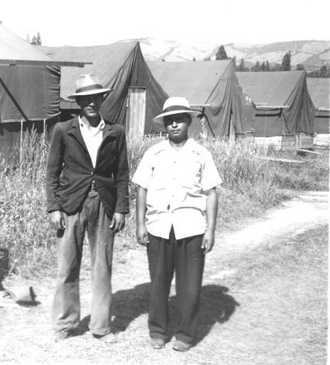
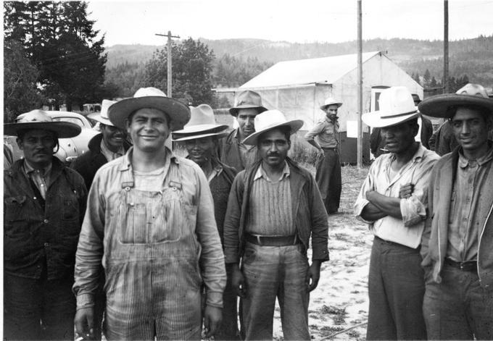
Mexican Agricultural Workers in Oregon through the Braceros Program, 1942-1947
Workers playing guitars, 1942/47, Braceros in Oregon Photograph Collection, P20:1070, Oregon State University
New arrivals, Hood River, 1942/47, Braceros in Oregon Photograph Collection, P20:795, Oregon State University
Right: Mexican farm workers pose in camp, Hood River, 1942/47, Braceros in Oregon Photograph Collection, P20:791, Oregon State University

Slide 15
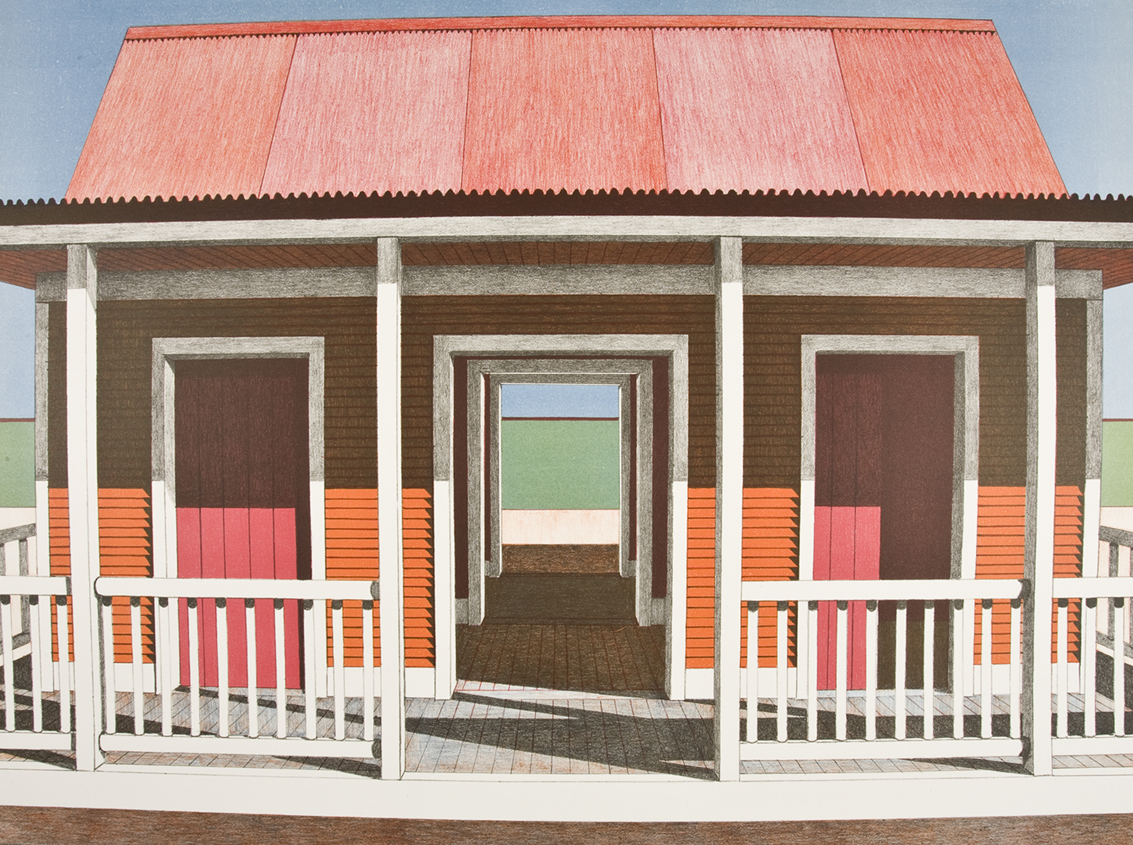
Casita al Mar, 1974
Emilio Sánchez
(Cuban, 1921-1999)
Color lithograph
H. 22 x W. 29.5 inches
Jordan Schnitzer Museum of Art, University of Oregon; Gift of the Emilio Sanchez Foundation. 2011:24.12

Slide 16
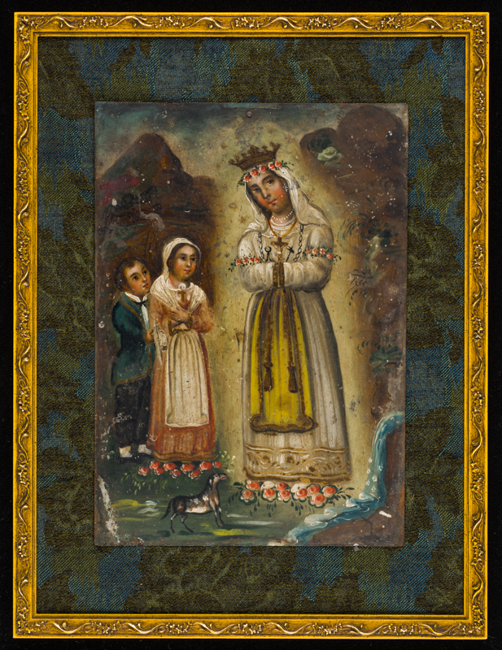
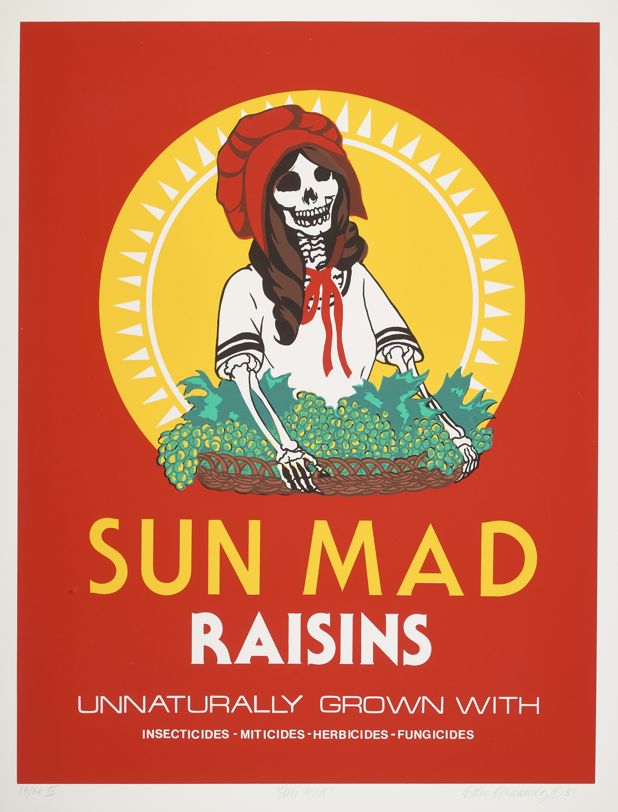
Nuestra Señora de Salette, probably 1850’s-1860’s
Oil on tin
H. 10 x W. 7 inches
Jordan Schnitzer Museum of Art, University of Oregon; Gift of Dr. Don E. and Carol Steichen Dumond. 2018:26.2
Sun Mad, 1982
Ester Hernández
(Mexican-American, b. 1944)
Screen print
H. 30 x W. 22 inches
Jordan Schnitzer Museum of Art, University of Oregon; Purchase in honor of Jill Hartz, 2019:30.1

Slide 17
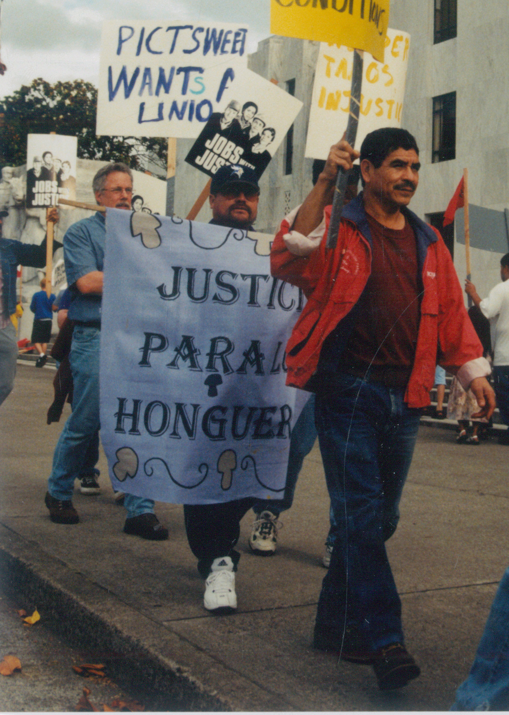
Leodegarlo Vallejo Marching in Protest at the State Capitol in Salem Oregon
Leodegarlo Vallejo Marching in Protest at the State Capitol in Salem Oregon, 1960/2015, Oregon Latino Heritage, UA142, Special Collections and University Archives, University of Oregon Libraries, Eugene, Oregon.

Slide 18
Discussion:
What steps should a museum or library take when adding a new collecting area?

Slide 19
Activity:
For each fictional collection, consider how it fits with the collecting strengths of the UO Libraries Special Collections and University Archives, its degree of historical interest, and the resources that might be required to care for it.

Slide 20
The following are the core collecting areas for the Special Collections and University Archives Department at the University of Oregon Libraries:
      Oregon authors
      Intentional communities
      Women’s movement
      Northwest history and culture
      Authors and illustrators of children’s books
      Environmental history
      Northwest photography

Slide 21
Collection 1: The Dorothea A. Reginald Postcard Collection
From 1953 through 1987, Dorothea A. Reginald, a resident of Kansas City, MO vacationed at Cannon Beach on the Oregon Coast each summer and sent postcards to her niece, Veronica Allsnip, in Boston. Ms. Allsnip kept them and would like to donate the collection of 42 postcards to the UO Libraries
The postcards themselves are common images of Oregon Coast landmarks, widely circulated at the time. Reginald’s lively and vivid text primarily describes vacation activities (hiking, tidepooling) alongside anecdotes of family life.
Core Collecting Areas
Oregon Authors
Intentional Communities
Women’s Movement
Northwest History and Culture
Authors and Illustrators of Children’s Books
Environmental History
Northwest Photography

Slide 22
Collection 2: The Wyland Smythe Papers
Wyland Smythe’s novel, The Oak and the Grass, an epic account of four generations of a farm family in the Willamette Valley, was shortlisted for the National Book Award in 1953. Smythe (1928-2004) lived his entire life in Philomath, Oregon. Meticulous in his standards, he never produced another published work.
Smythe’s papers include notes, drafts, and proofs of The Oak and the Grass, as well as reams of unpublished attempts at a second novel. Smythe never discarded work in case he wished to return to a previous idea, and his nephew describes the collection as ”a garage full” of boxes of paper.
Core Collecting Areas
Oregon Authors
Intentional Communities
Women’s Movement
Northwest History and Culture
Authors and Illustrators of Children’s Books
Environmental History
Northwest Photography

Slide 23
Collection 3: The Martinez Family Photo Album
Hector Carlos Martinez moved to Oregon in the 1940s through the Bracero program, which brought agricultural laborers to the state from Mexico during World War II. After the war, he married Estella Figueroa, whose family had lived in Oregon for decades, and moved to Salem, where he worked at a local timber mill. In the 1950s, the Martinez family was one of four Latinx families living in the city.
Hector and Estella’s grandchildren would like to donate a family album that includes pictures of Hector and Estella’s life in Salem from 1948-1964. They would like the album to be digitized and made widely available to promote Latinx heritage in the state.
Core Collecting Areas
Oregon Authors
Intentional Communities
Women’s Movement
Northwest History and Culture
Authors and Illustrators of Children’s Books
Environmental History
Northwest Photography

Slide 24
Collection 4: The Sunflower Papers
Sunflower was an intentional community in Colorado from 1971 through 1978. Founded by former members of Earthlove, a well-known Oregon intentional community (whose papers are held by UO Libraries), Sunflower shared many of the same ideals but was strictly vegan; its members left Earthlove in part due to debates around the keeping of animals for milk and eggs on Earthlove’s farm.
The collection consists of 3 bankers boxes of diverse ephemera including flyers, event posters, meeting minutes, charter drafts, account books, and more.
Core Collecting Areas
Oregon Authors
Intentional Communities
Women’s Movement
Northwest History and Culture
Authors and Illustrators of Children’s Books
Environmental History
Northwest Photography

Slide 25
Closing Reflection:
How do you think who was doing the collecting shaped the kinds of objects and records that entered collections?
How do you think the sense of what is “collectable” may have changed over time?
How can museums and libraries address and respond to the historical factors that shaped their collections?

Slide 26
Rights
Special Collections and University Archives, University of Oregon
For information about reproduction and use of copyrighted works, please contact SCUA at spcarref@uoregon.edu
Works In Copyright
(17) Leodegarlo Vallejo Marching in Protest at the State Capitol in Salem Oregon
Copyright Unknown
(5) PH014_90-19 Gertrude Bass Warner photographs
Oregon State University Archives, Oregon State University
For information about reproduction and use of copyrighted works, please email scarc@oregonstate.edu
Works in Copyright
(14) Workers playing guitars
(14) New arrivals, Hood River
(14) Mexican farm workers pose in camp, Hood River

Slide 27
Rights, continued
Jordan Schnitzer Museum of Art, University of Oregon
For information about reproduction and use of copyrighted works, please email jsmith3@uoregon.edu
Works In Copyright
(9) Morris Graves [Journey III, circa 1943]
(12) Rick Bartow, [Mad River Johnny VII, 2015]
(12) Brian Lanker, [Toni Morrison, ca. 1986-7; printed, ca. 1989]
(12) AMANO Kunihiro, [Imagination 39, 1972]
(15) Emilio Sánchez, [Casita al Mar, 1974]
(16) Ester Hernández, [Sun Mad, 1982]

Slide 28

Sponsors
The Uniting Collections curriculum is the result of a collaboration between the University of Oregon Libraries and the Jordan Schnitzer Museum of Art, with support from The Andrew W. Mellon Foundation.
Licensing
This work is licensed under a Creative Commons Attribution-NonCommercial-Sharealike 4.0 International License to Daphne Gallagher and the University of Oregon, 2020.
This work may be adapted and reused by educators in schools, museums, libraries, or any other non-profit context. You are encouraged to adapt the content to your institution. If you have any questions about your use of this resource, please contact Daphne Gallagher (daphne@uoregon.edu)
Individual works included in the PowerPoint may be under copyright or separate license. Please refer to the Rights slide(s) for more information.

