Slide 1
UNITED COLLECTIONS
Open Resources for Teaching Special and Museum Collections

Slide 2
CARING FOR COLLECTIONS
What Does it Mean to Care for a Collection?

Slide 3
Group Brainstorm
What does it mean to care for a collection?

Slide 4
PRESERVING PHYSICAL INTEGRITY

Slide 5
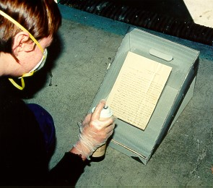
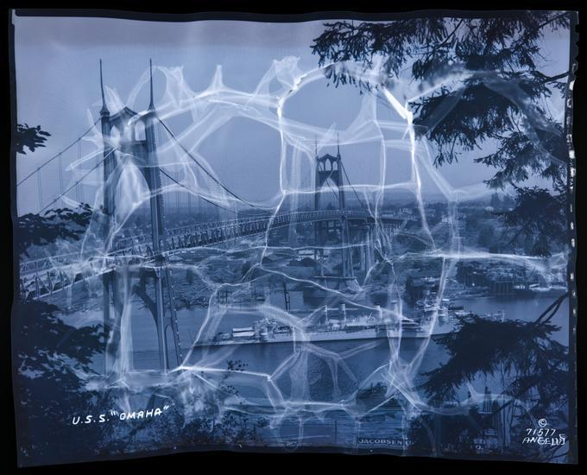
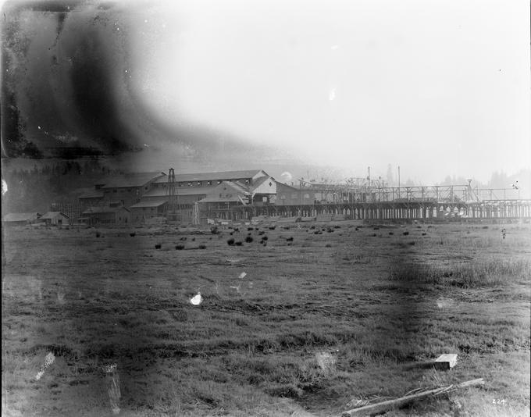
Using a deacidifying spray to stabilize a document written on acidic paper
Courtesy of UO Libraries
Nitrate negatives in deteriorated condition
Top: PH037_b183_71577, 1880/1947, Angelus Studio photographs, 1880s-1940s, PH037, Box 183, Special Collections & University Archives, University of Oregon Libraries, Eugene, Oregon
Bottom: PH037_b153_T00082 Angelus Studio Photographs, 1880/1949, Angelus Studio photographs, 1880s-1940s, PH037, Box 153, Special Collections & University Archives, University of Oregon Libraries, Eugene, Oregon

Slide 6
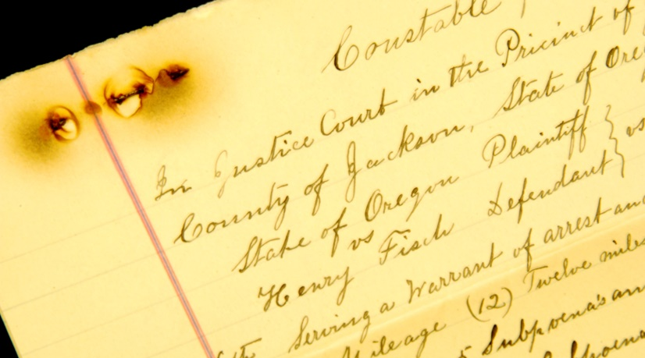
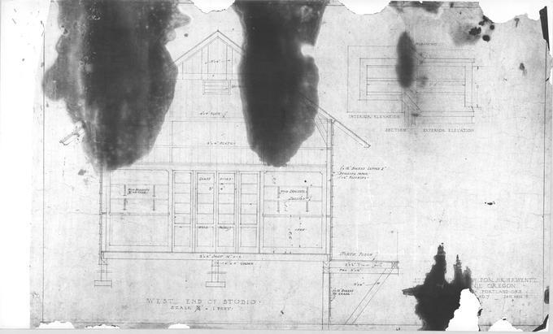
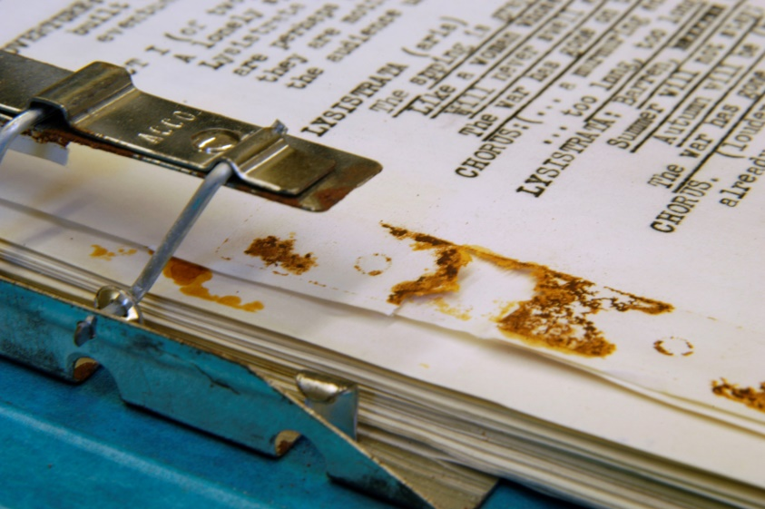
Courtesy of UO Libraries
Plans, Elevations (f33) [27], 1965, John Yeon architectural drawings, 1934-1976, Coll 333, Folder 33, Special Collections & University Archives, University of Oregon Libraries, Eugene, Oregon
Courtesy of UO Libraries

Slide 7
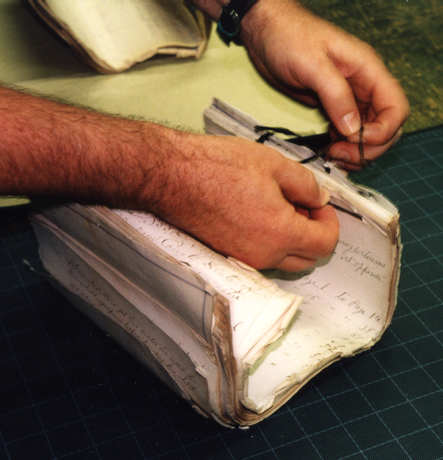
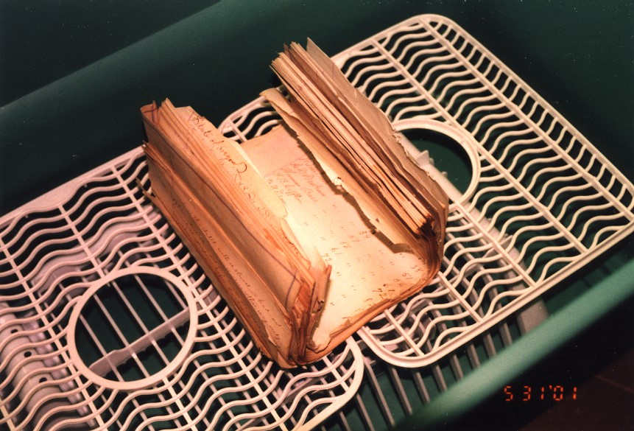
Courtesy of UO Libraries
Courtesy of UO Libraries

Slide 8
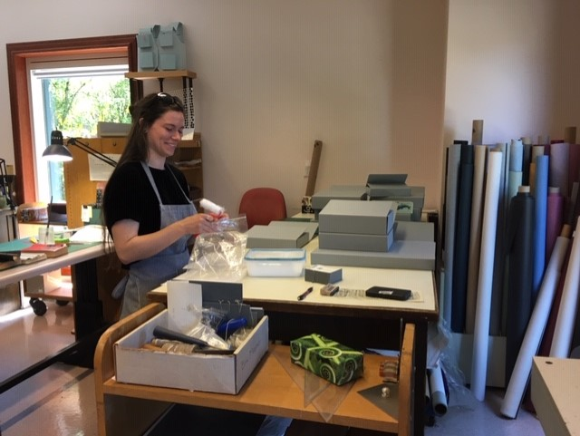
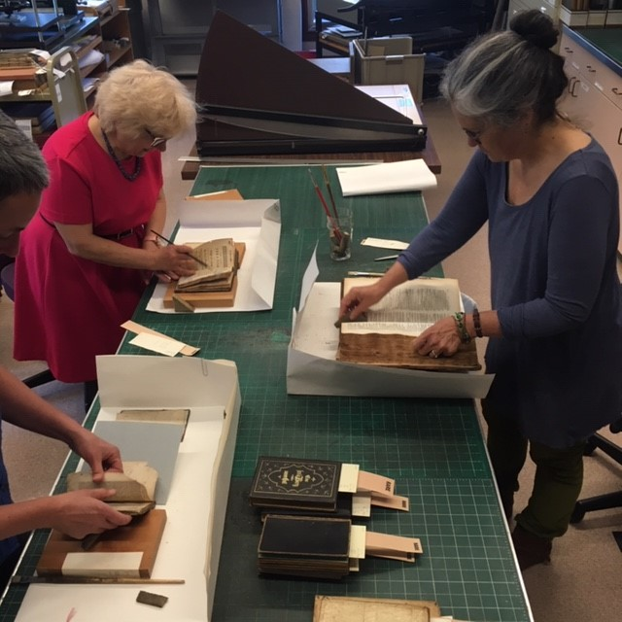
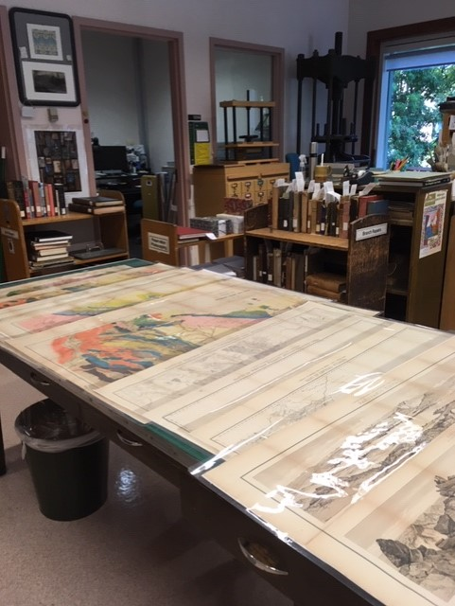
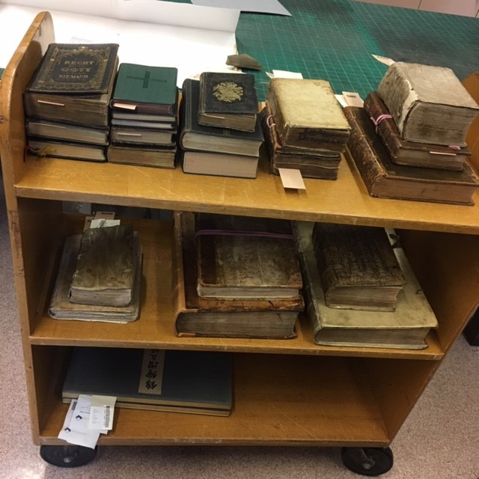
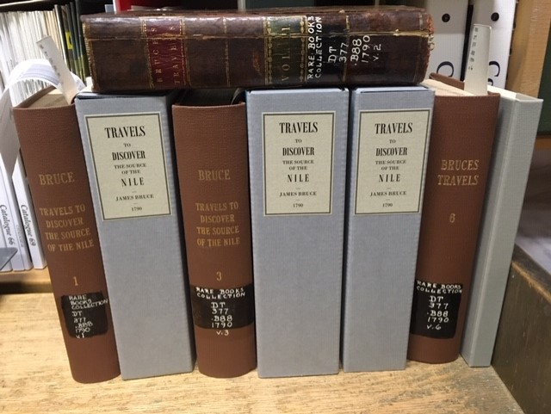
Courtesy of UO Libraries
Courtesy of UO Libraries
Nitrate negatives in deteriorated condition
Courtesy of UO Libraries
UO Libraries Beach
Conservation Lab
Courtesy of UO Libraries
Courtesy of UO Libraries

Slide 9
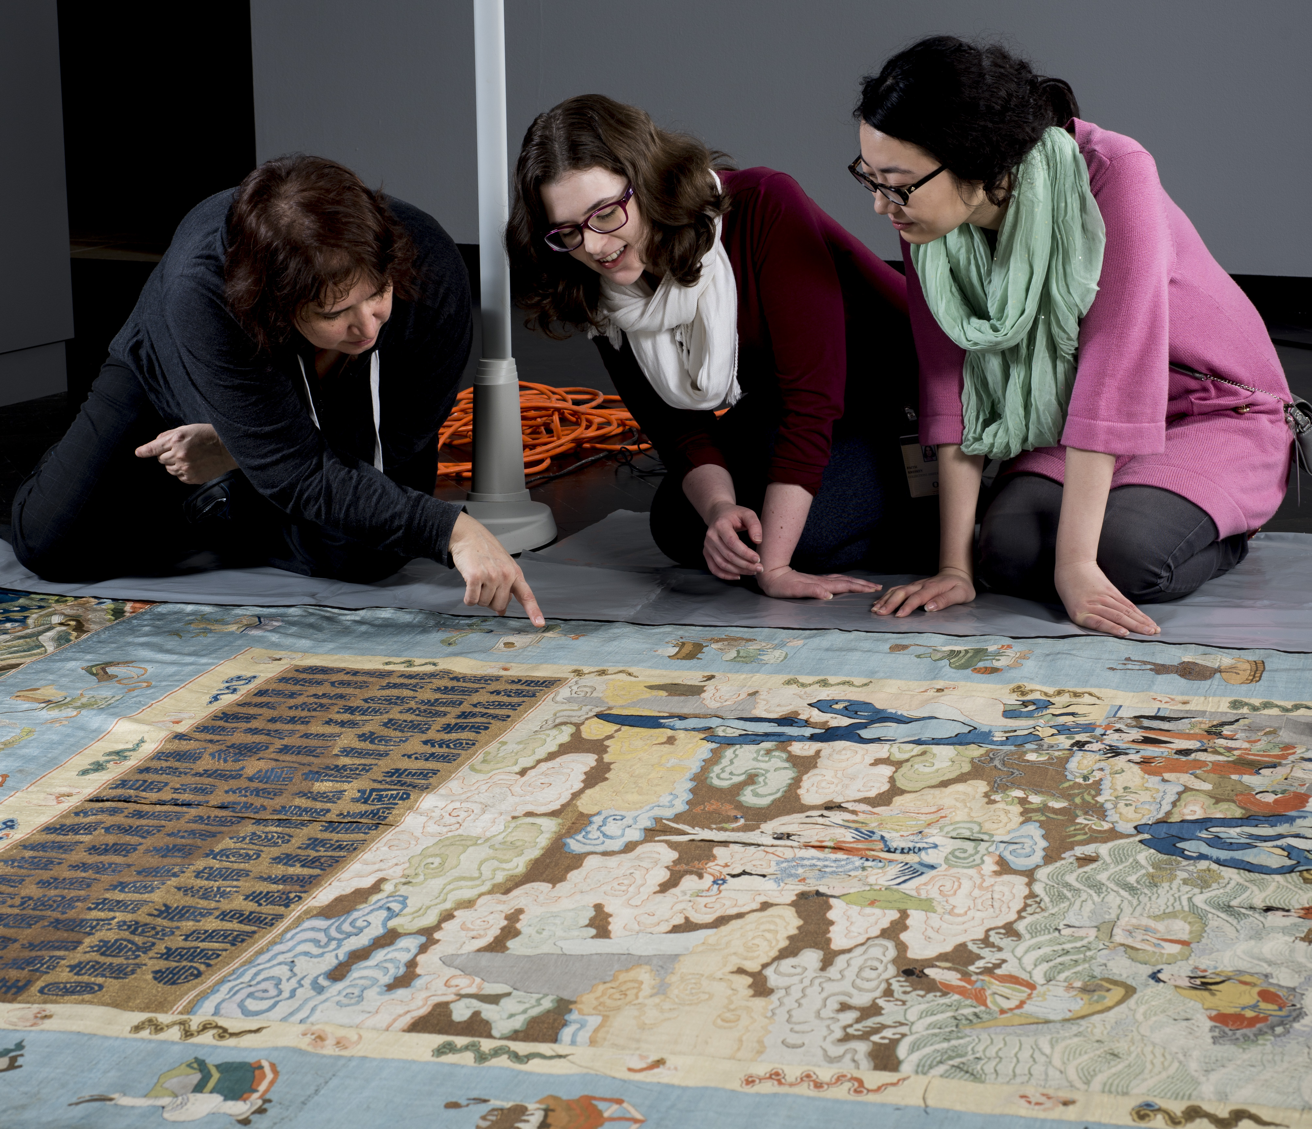
Textile conservator Beth Szuhay, working with UO graduate students Faith Kresky and Han Zhu, Courtesy of Jordan Schnitzer Museum of Art

Slide 10
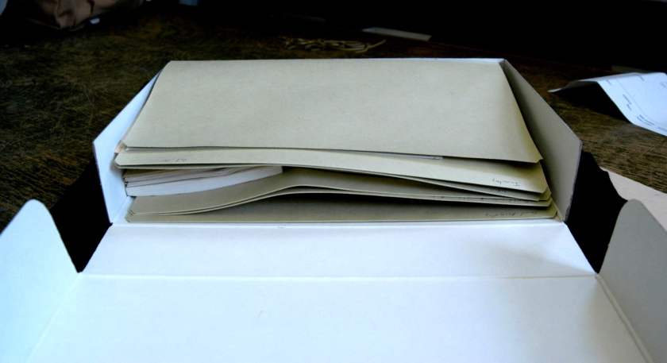
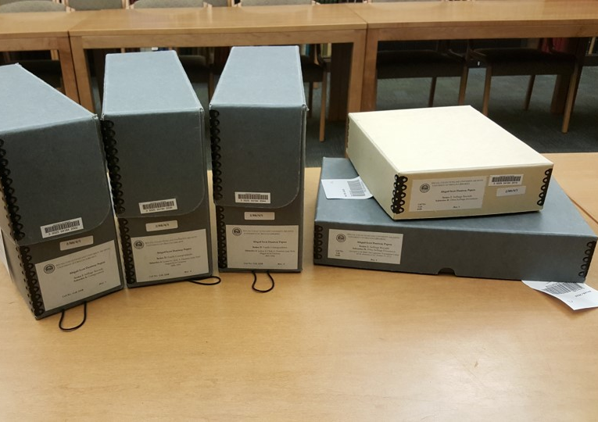

Courtesy of UO Libraries
Courtesy of UO Libraries
Courtesy of UO Libraries

Slide 11
UO Libraries Special Collections Storage
Courtesy of UO Libraries

Slide 12
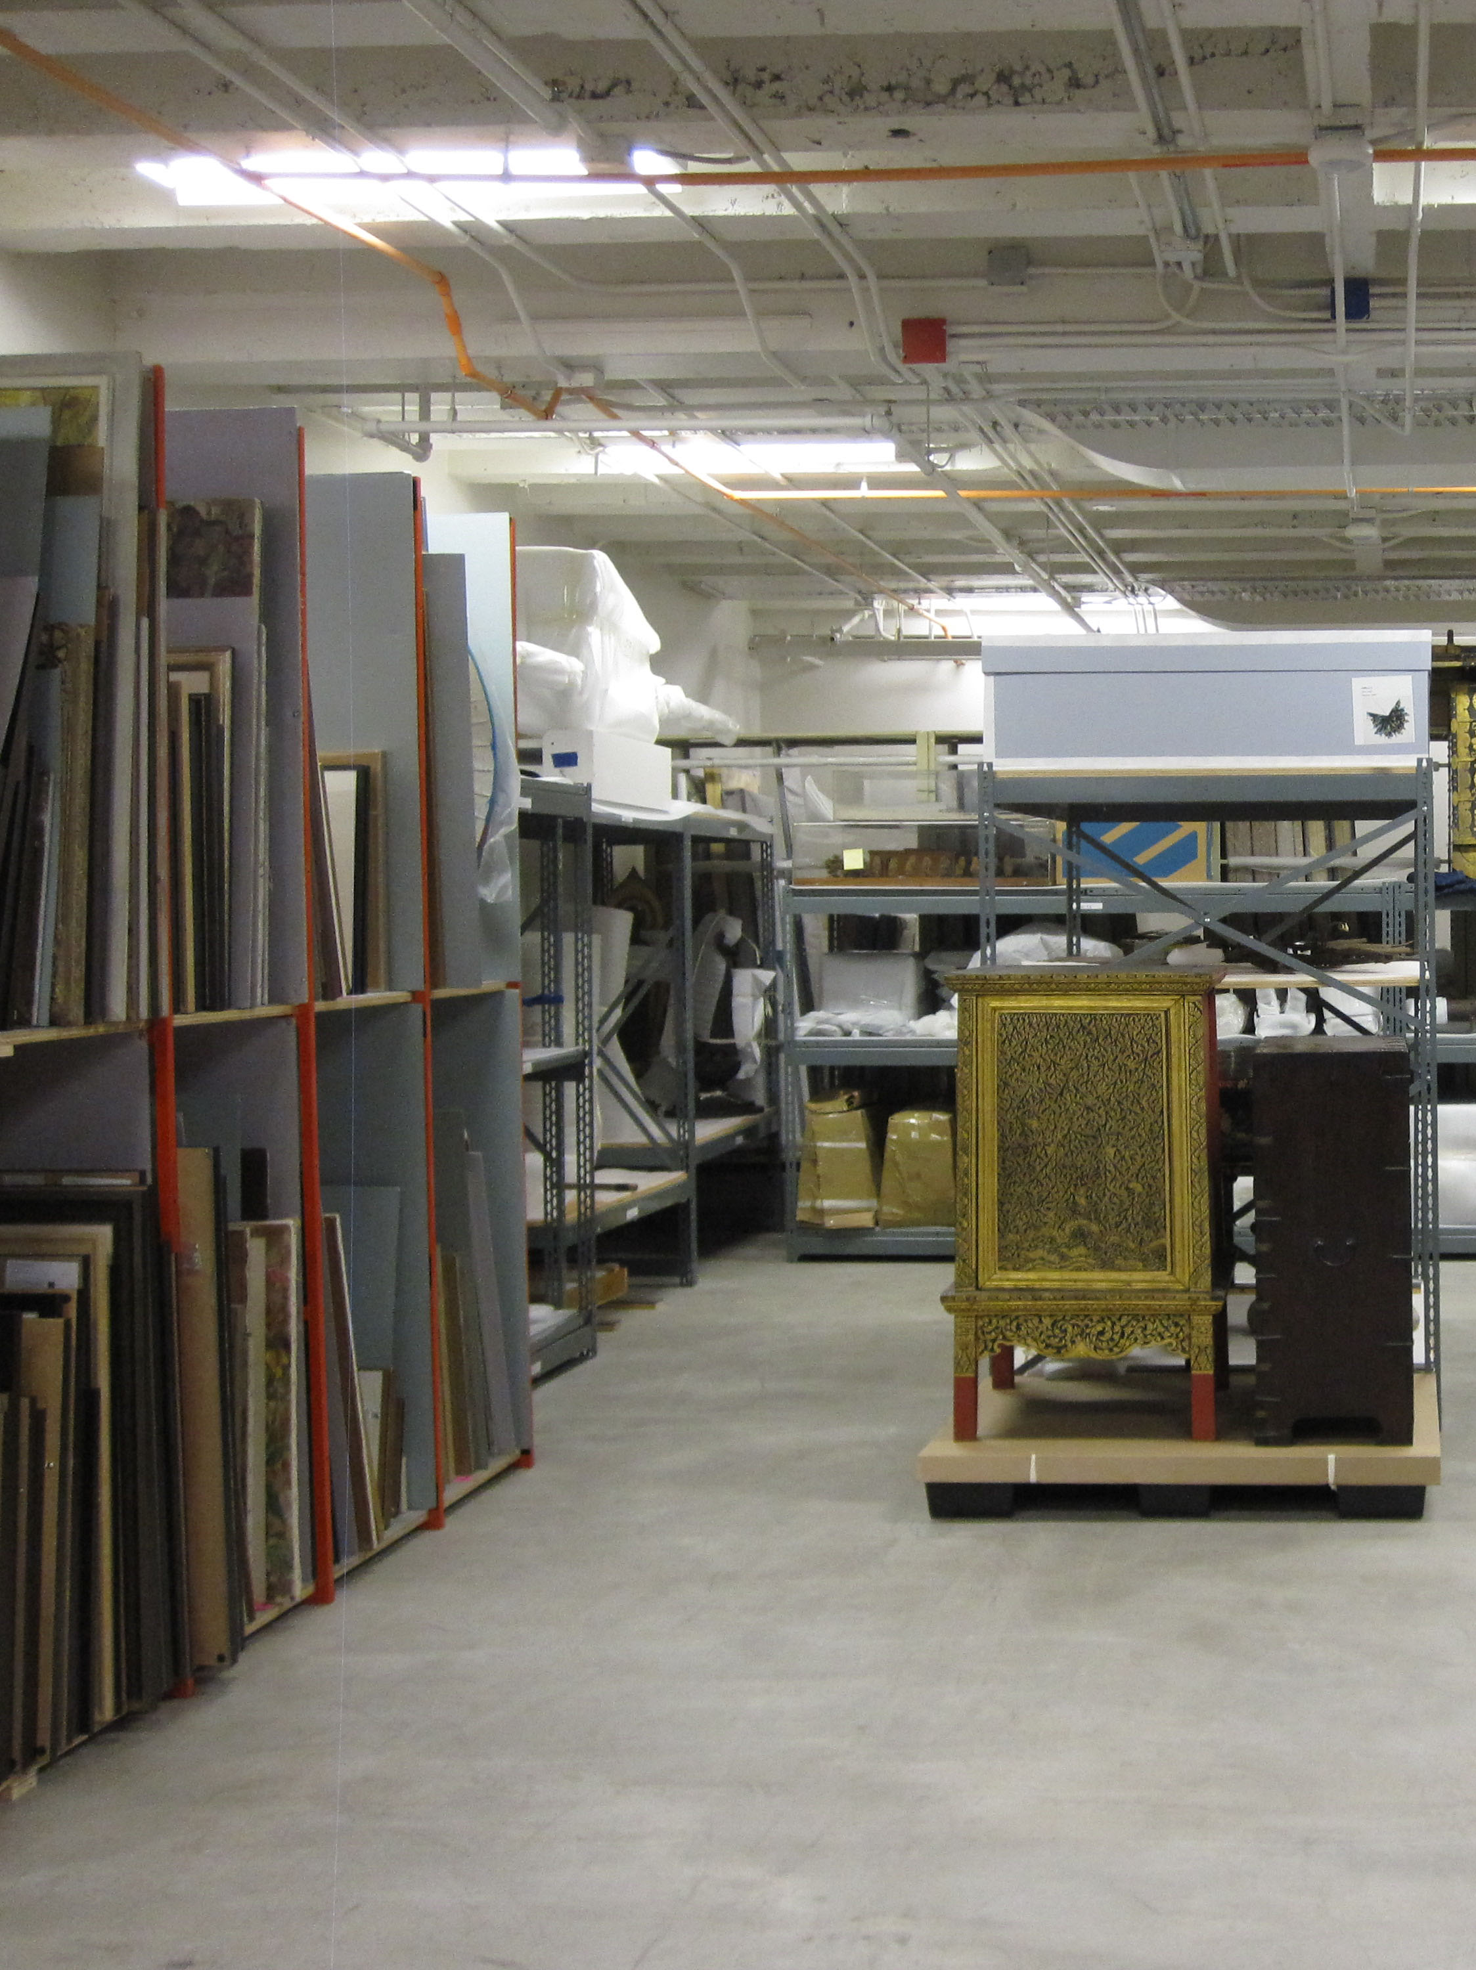
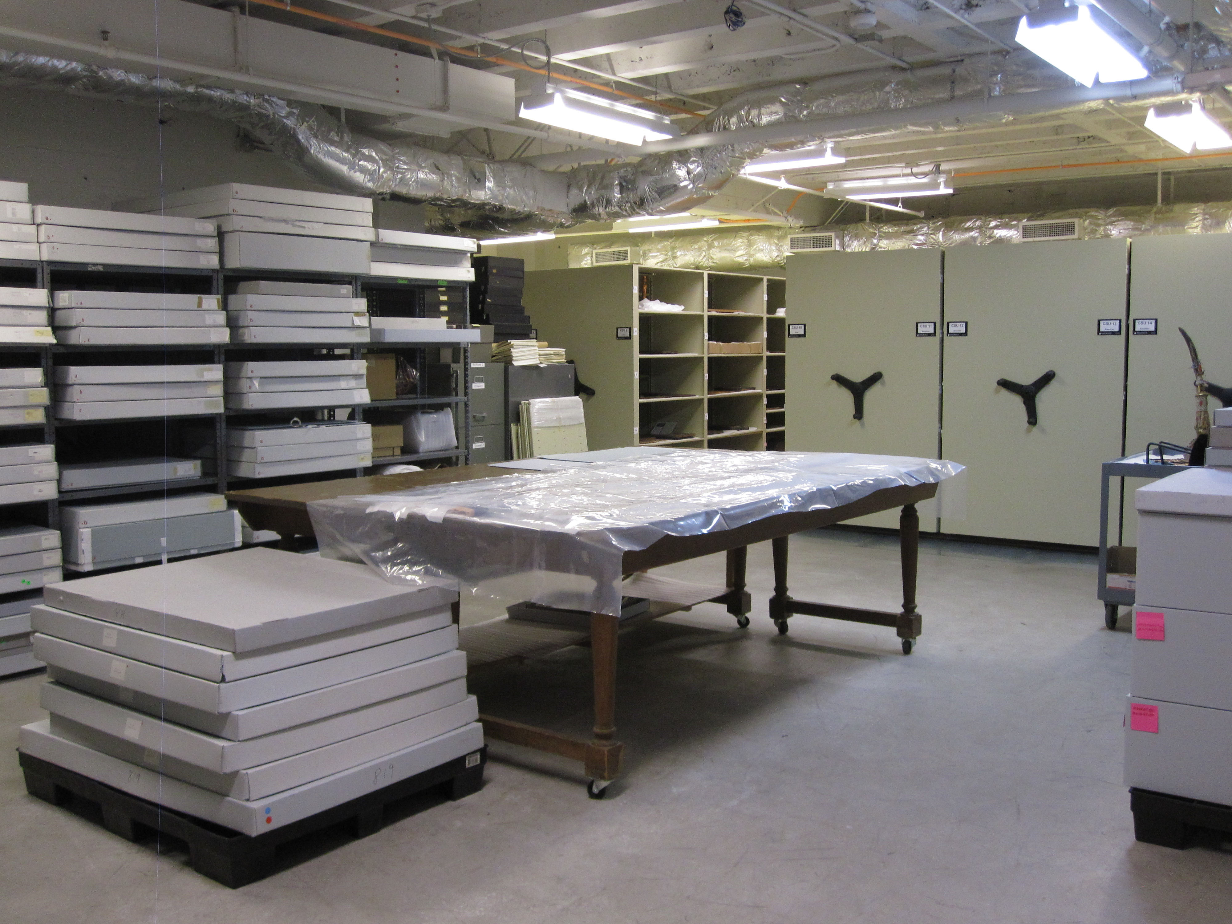
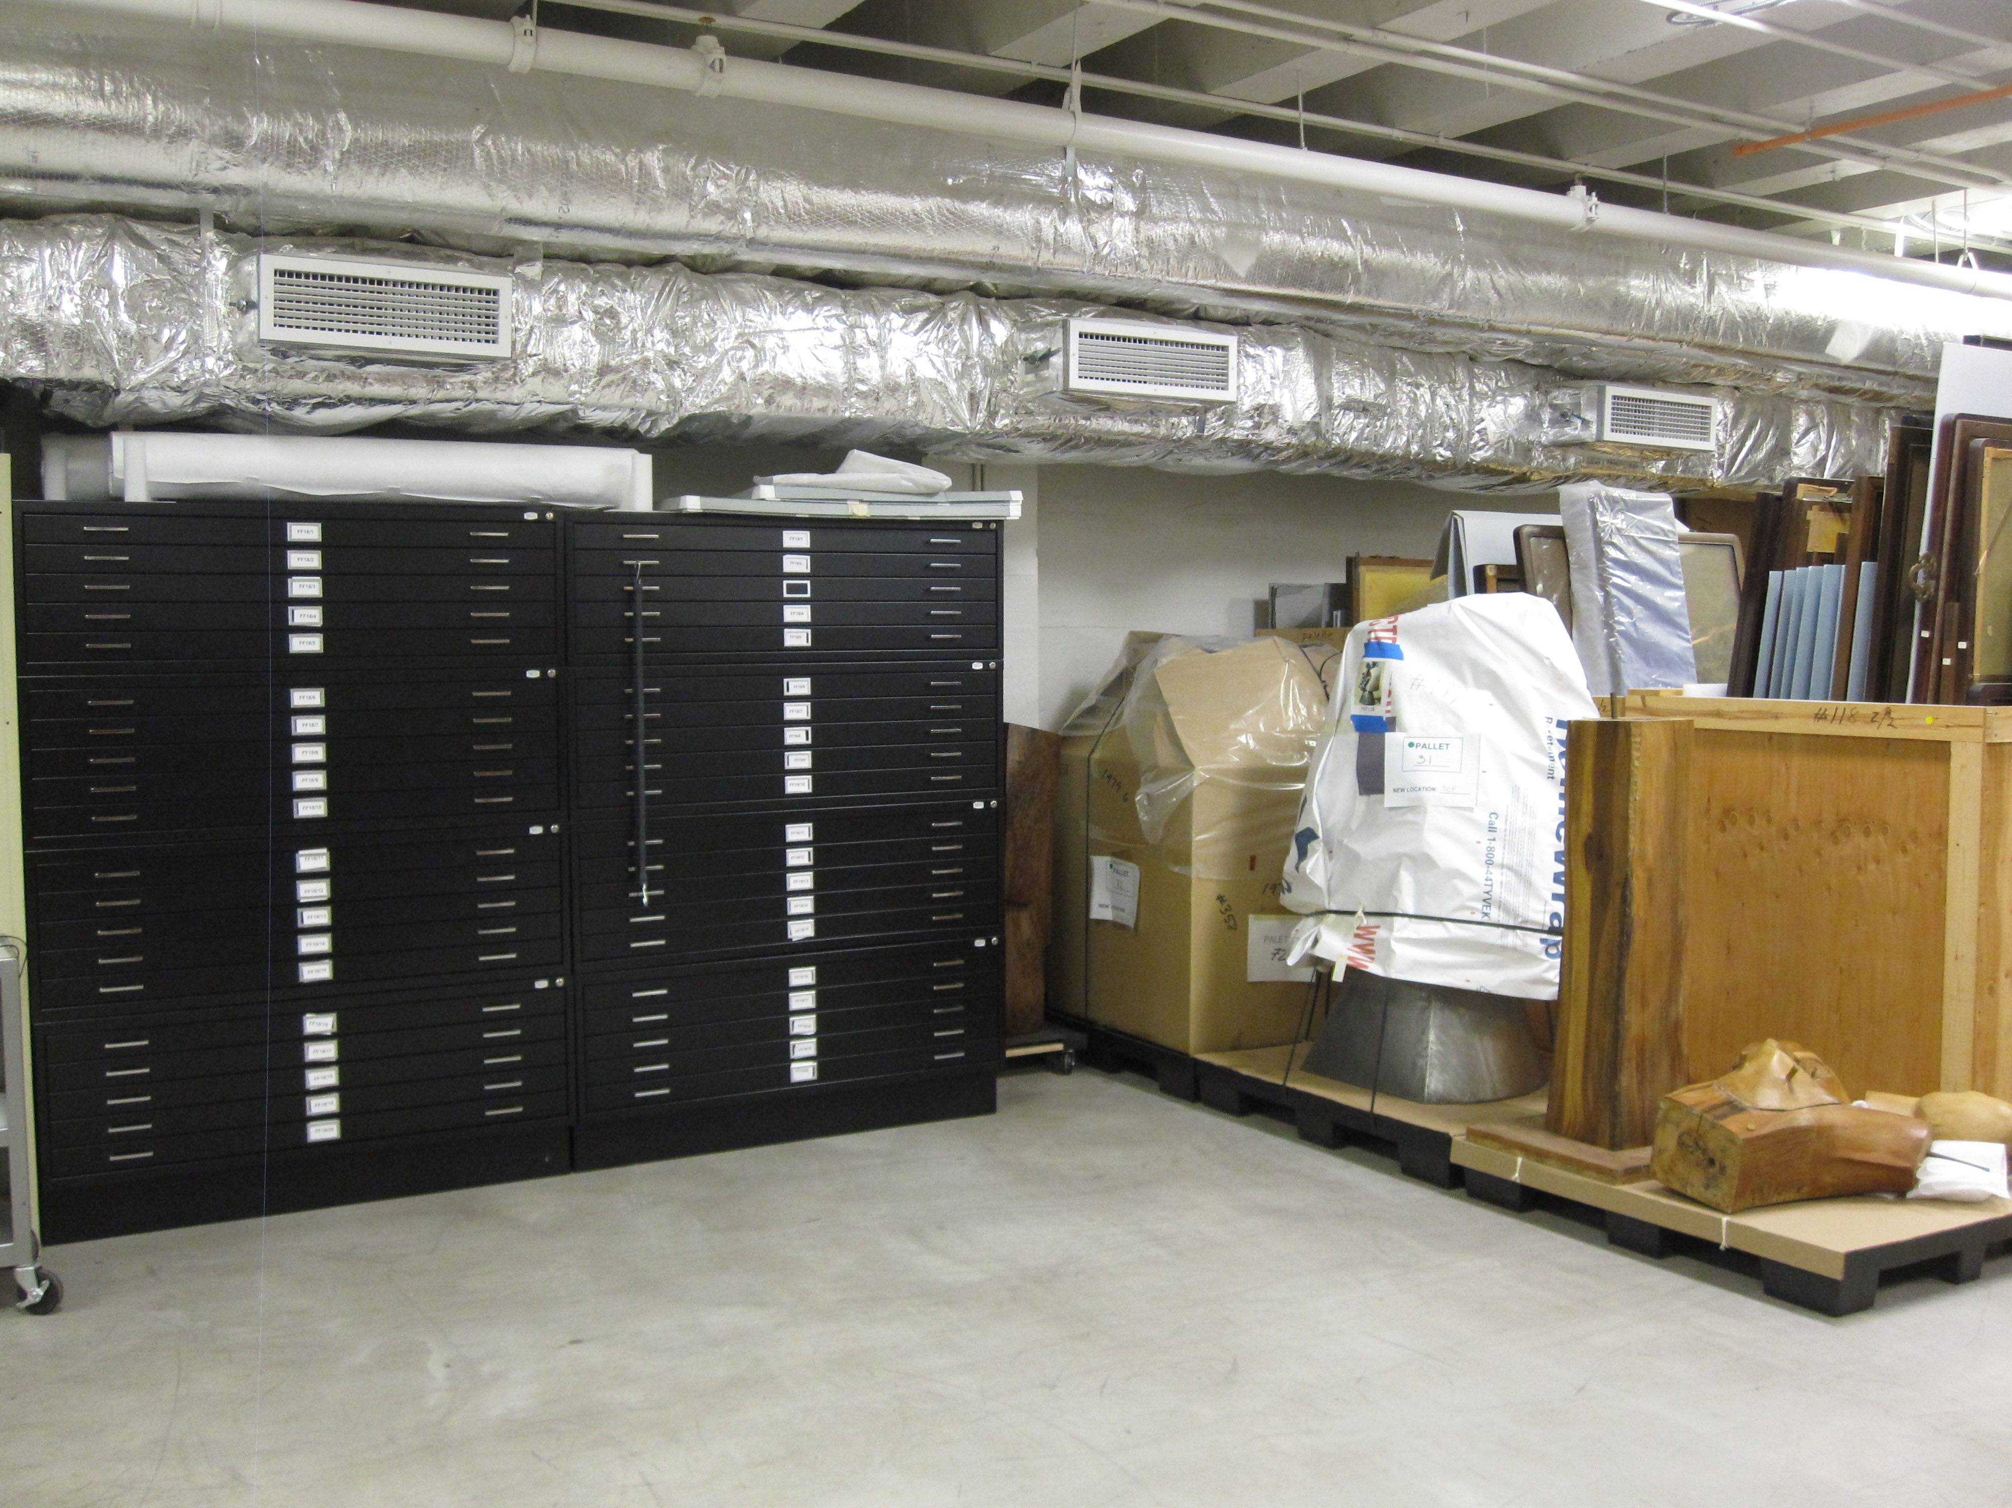
Jordan Schnitzer Museum of Art Collections Storage
Courtesy of Jordan Schnitzer Museum of Art

Slide 13
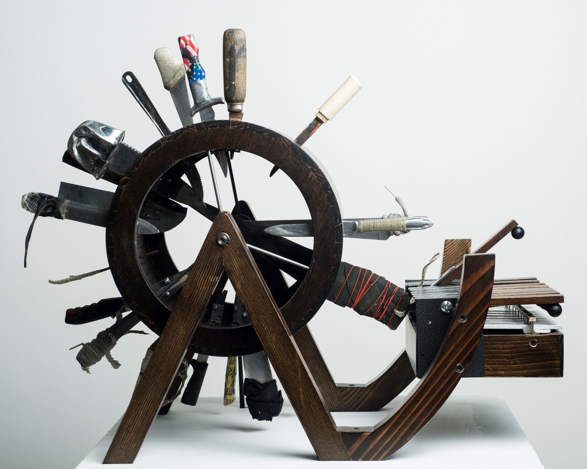
Risus Sativus, 2011
Carlos Castro Arias
(Columbian, b. 1976)
Multimedia, wood, knives
H. 60-1/2 x W. 20-1/2 x D. 26 inches
Jordan Schnitzer Museum of Art, University of Oregon; Museum purchase with funds from the Ramsing Estate, 2013:40.1

Slide 15
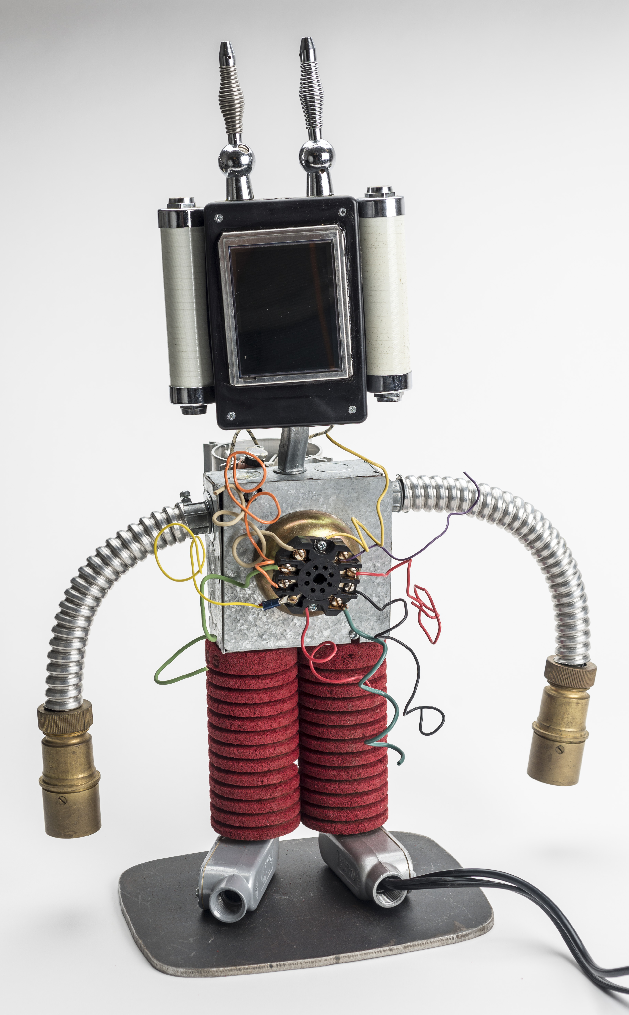
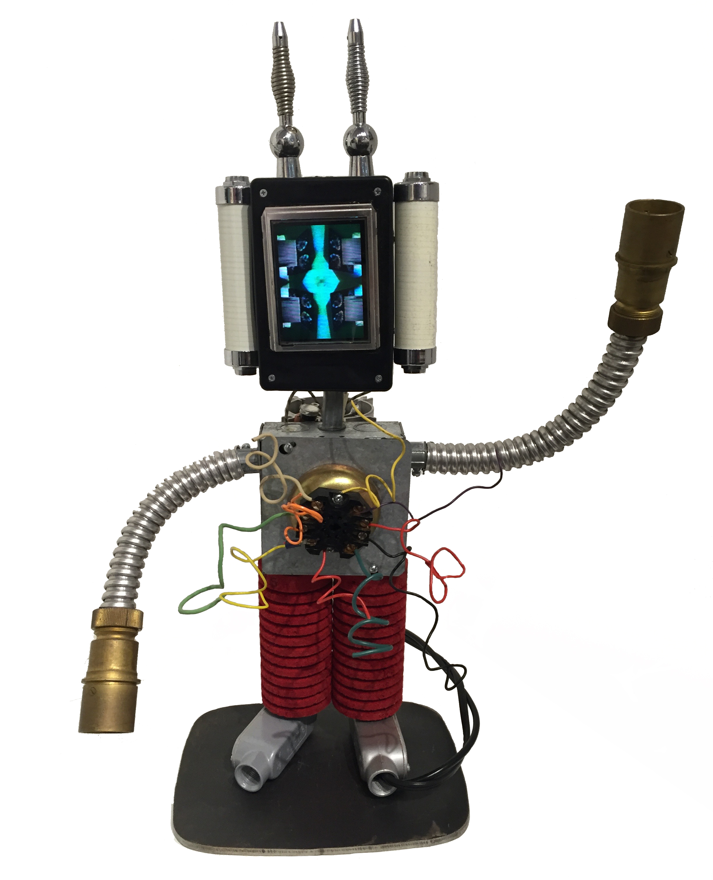
Lilliputian 2000, 2000
PAIK Nam June
(Korean-born American, 1932-2006)
Mixed media, LCD, single-channel
H. 24 x W. 16 x D. 6 inches
Jordan Schnitzer Museum of Art, University of Oregon; Purchase made possible by Alvin Friedman-Kien & Ryo Toyonaga and the Farwest Steel Korean Art Endowment, 2015:44.1

Slide 16
Questions:
Should museums and library special collections have the goal of preserving everything in their collection forever?
Should museums and library special collections care for every object in the same way or should objects that are more delicate be treated differently? What about objects that are more rare or valuable?
What principles should be used to decide how an individual object or item is treated?

Slide 17
CATALOGUING COLLECTIONS
Or if a collection is uncatalogued does it exist?

Slide 18
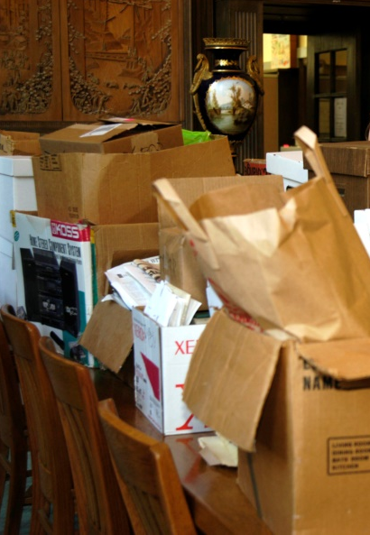
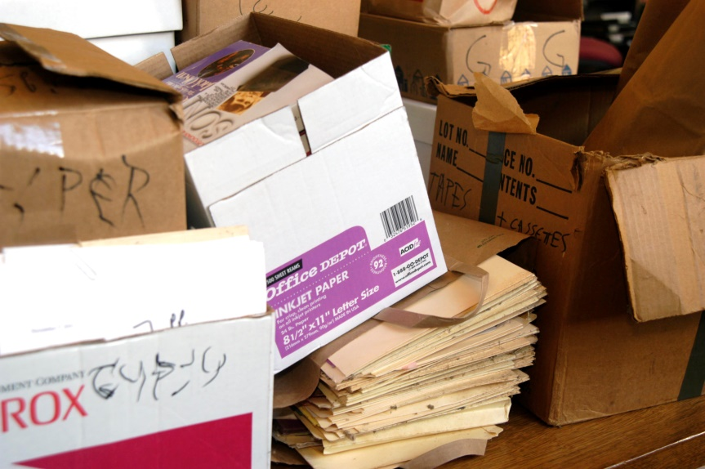
Courtesy of UO Libraries
Courtesy of UO Libraries

Slide 19
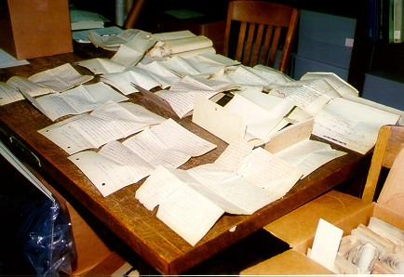
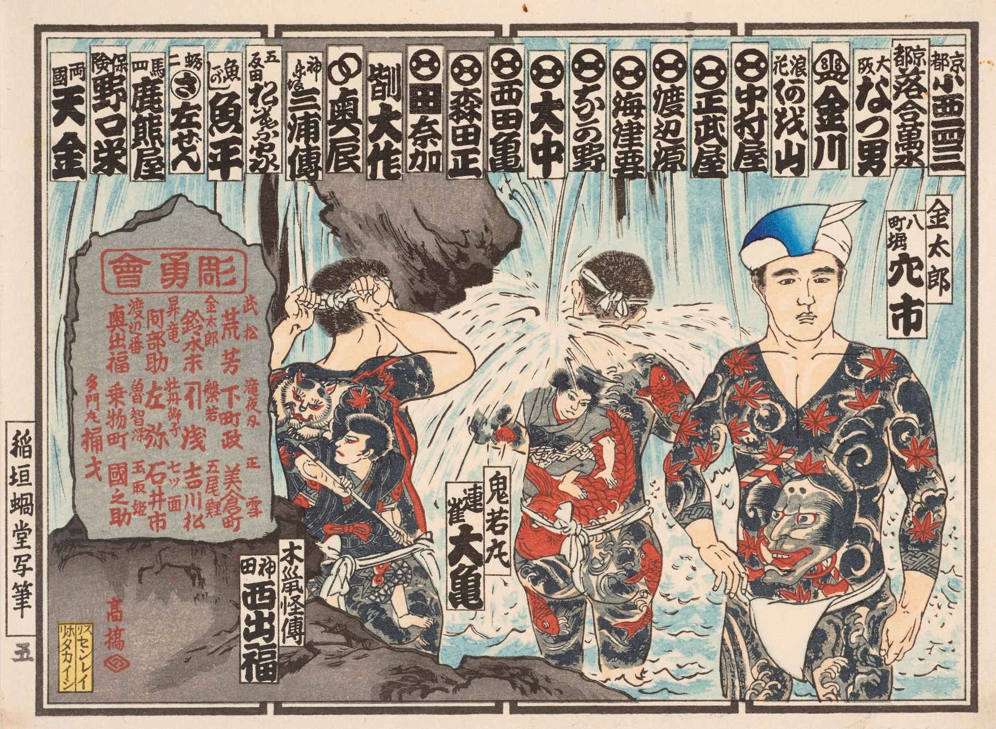
Processing Jackson County Records, UO Libraries Special Collections
Courtesy of UO Libraries
Nosatsu of Chôyûkai Members Bathing in Waterfall [Suikoden mitate]
Japanese; Taishô period, 1925. Woodblock-printed nôsatsu (納札) or senjafuda (千社札) in yonchô format; ink and color on paper. H. 7-3/16 x W. 8-1/8 inches
Jordan Schnitzer Museum of Art, University of Oregon; Gift of Frederick Starr Estate, 1964:3.23.1696

Slide 20
Special Collections Storage,
UO Libraries
Courtesy of UO Libraries

Slide 21
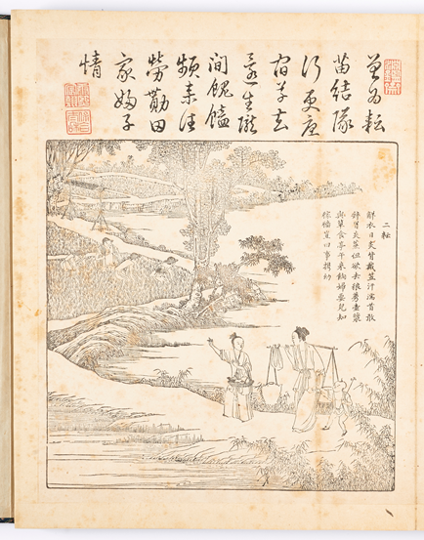
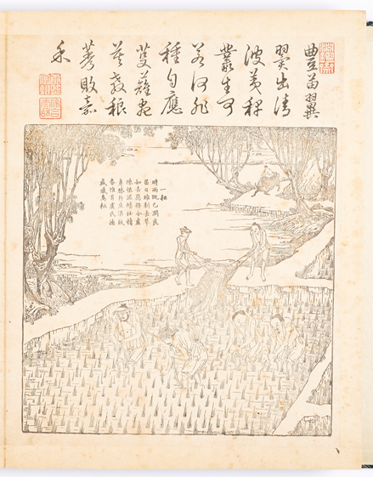

Slide 22
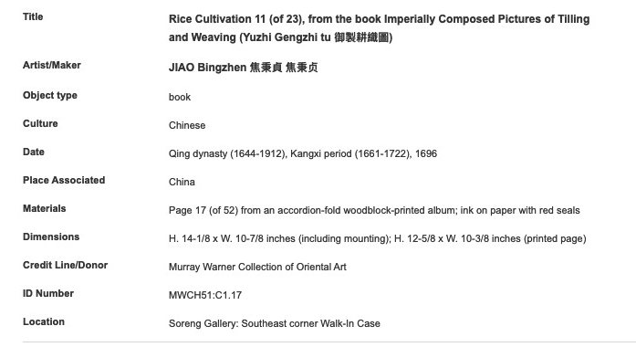

Slide 23
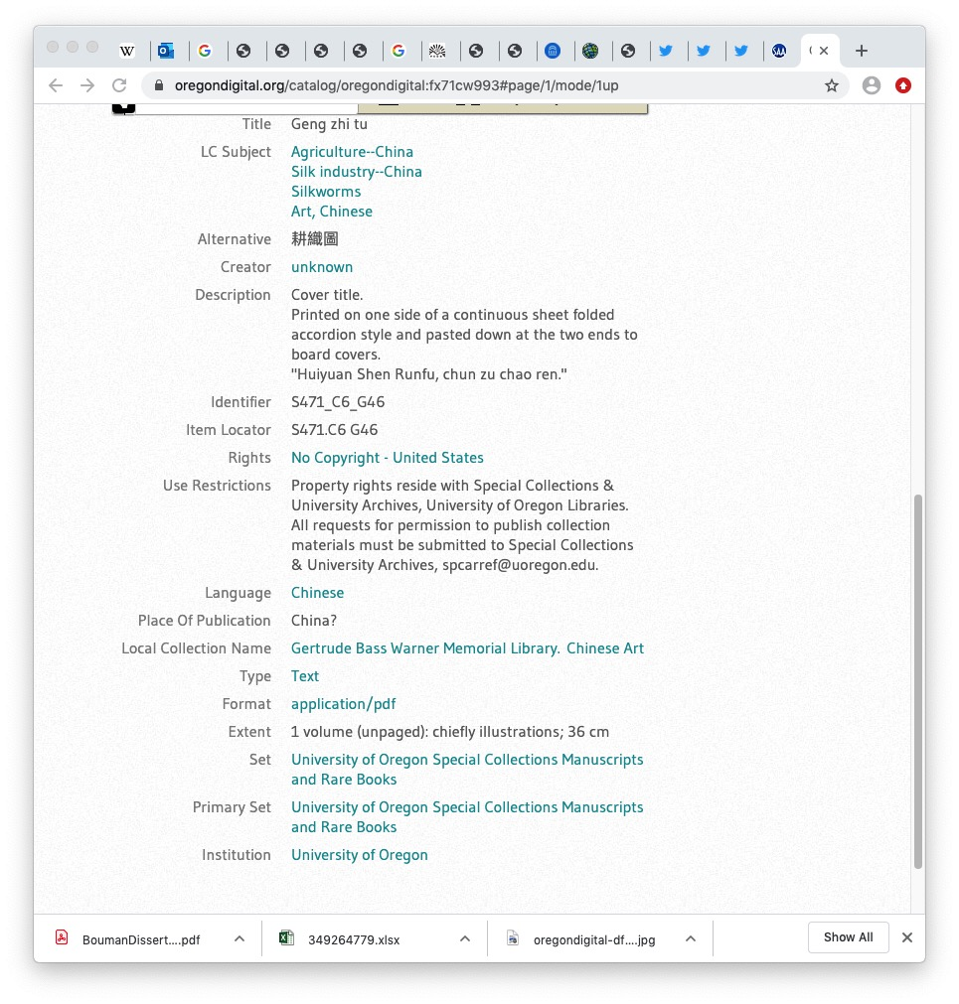

Slide 25
Closing Reflection:
Caring for collections requires expertise. What are some of the different types of skills needed for collections care?
Museums and libraries are often under-staffed and it can be easy to focus resources on more directly public-facing activities rather than behind the scenes collections care. Why is collections care critical? Why is it overlooked as a priority?

Slide 26
Rights
Special Collections and University Archives, University of Oregon
For information about reproduction and use of copyrighted works, please contact SCUA at spcarref@uoregon.edu
Works In Copyright
(5) PH037_b183_71577 Angelus Studio Photographs
(5) PH037_b153_T00082 Angelus Studio Photographs
(6) John Yeon, Plans, Elevations (f33) [27]
Jordan Schnitzer Museum of Art, University of Oregon
For information about reproduction and use of copyrighted works, please email jsmith3@uoregon.edu
Works In Copyright
(13) Carlos Castro Arias, [Risus Sativus, 2011]
(15) PAIK Nam June, [Lilliputian 2000, 2000]

Slide 27

Sponsors
The Uniting Collections curriculum is the result of a collaboration between the University of Oregon Libraries and the Jordan Schnitzer Museum of Art, with support from The Andrew W. Mellon Foundation.
Licensing
This work is licensed under a Creative Commons Attribution-NonCommercial-Sharealike 4.0 International License to Daphne Gallagher and the University of Oregon, 2020.
This work may be adapted and reused by educators in schools, museums, libraries or any other non-profit context. You are encouraged to adapt the content to your institution. If you have any questions about your use of this resource, please contact Daphne Gallagher (daphne@uoregon.edu)
Individual works included in the PowerPoint may be under copyright or separate license. Please refer to the Rights slide(s) for more information.

